Slide 1
E-MUSTER-ROLL AND electronic FUND MANAGEMENT SYSTEM
(e-MUSTER-ROLL, e-FMS )
Prepared & Designed by
MIS SECTION
MGNREGA, JALPAIGURI

Slide 2
GENERATED E-MUSTER ROLL & SIGNATURE WITH ISSUE OFFICER &SEAL
JOB CARD RENUAL
ACCOUNT FREEZE OF JOB CARD HOLDER
PAYMENT THROUGH POST OFFICE AND BANK (EFMS OF PANCHAYAT SAMITY AND OTHER)
IF EFMS :
FTO GENERATED BY ACCOUNTANT (PANCHAYAT SAMITY)
FTO APPROVED BY P.O & B.D.O (PANCHAYAT SAMITY AND GRAM PANCHAYAT INCASE OF PRODHAN ABSENT))
DIAGRAM OF MIS
SCHEME ENTRY
FILL E-MUSTER ROLL WITHOUT PAYMENT DATE
GENERATED WAGES LIST
PAYMENT THOUGH POST OFFICE AND BANK (ONLY FOR CHEQUE)
PROGRAM OFFICER
SEND THE ALLOCATION LIST TO P.O FOR GENERATED E-MUSTER ROLL
PANCHAYAT SAMITY
GENERATED ALLOCATION LIST FROM DEMANDING REGISTER AT GRAM PANCHAYAT LEVEL FOR EVERY PIA
LINE DEPARTMENT
REGISTRATION
ENTER ACCOUNT INFORMATION OF JOB CARD SEEKER.
DEMAND FOR WORK
ALLOCATION OF WORK FOR ALL PIA
FILL E-MUSTER ROLL WITHOUT PAYMENT
WAGES LIST GENERATED
PAYMENT THOUGH POST OFFICE & Bank(CHEQUE or EFMS)
IF EFMS :
GENERATED FTO BY EXECUTIVE ASSISTANT
APPROVED FTO BY PRODHAN
SCHEME ENTRY
FILL E-MUSTER ROLL WITHOUT PAYMENT
GENERATED WAGES LIST
PAYMENT THROUGH POST OFFICE & BANK(CHEQUE & EFMS)
IF EFMS THEN :
FTO GENERATED BY ACCOUNTANT.
FTO APPROVED BY ADMINISTRATIVE HEAD.
GRAM PANCHAYAT

Slide 3
ACCOUNT INFORMATION OF JOB CARD HOLDER

Slide 4
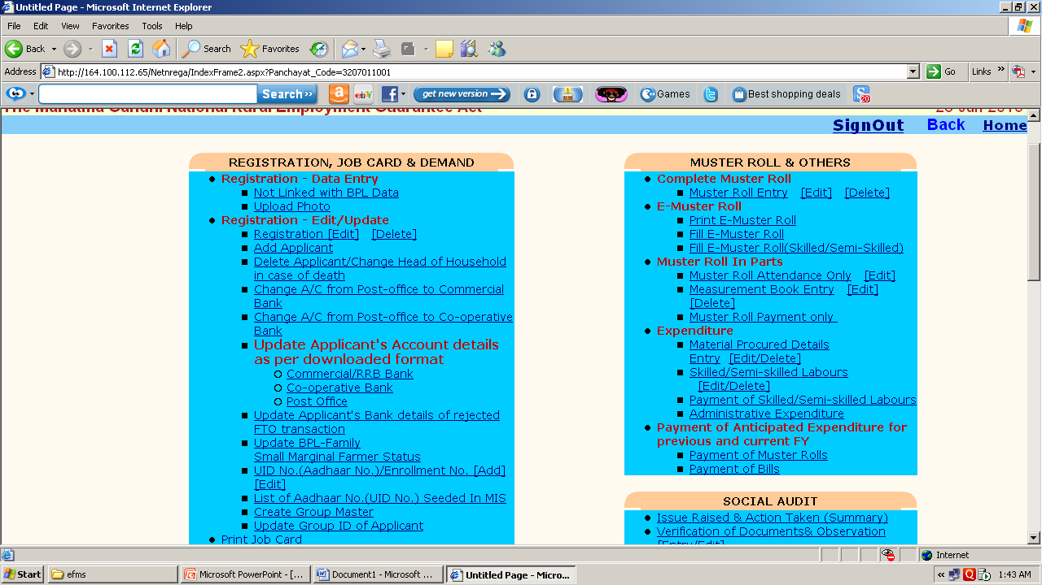
CHANGE A/C FROM POST-OFFICE TO COMMERCIAL BANK AND CO-OPERATIVE BANK

Slide 5
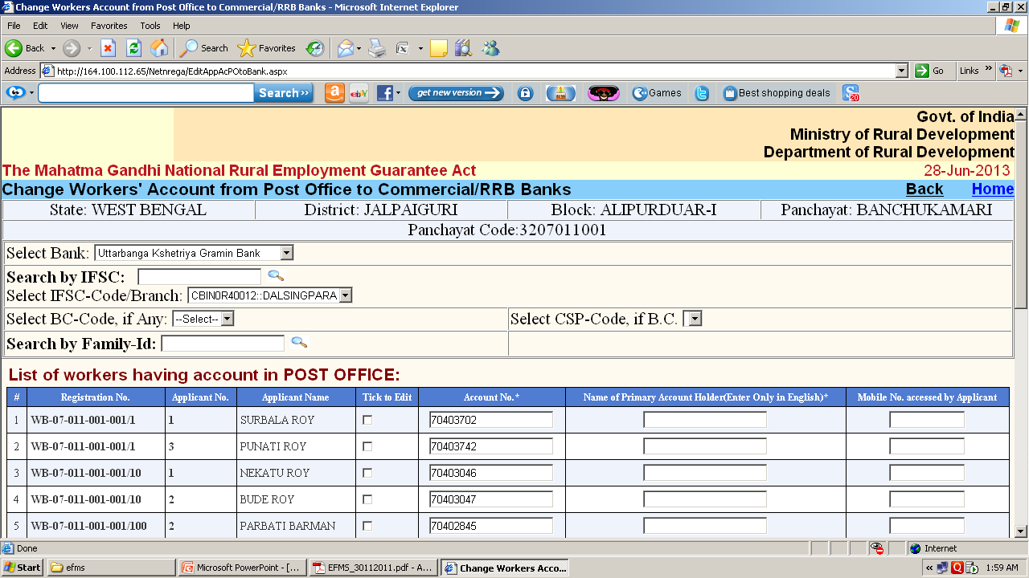
CHANGE WORKERS’ ACCOUNT FROM POST OFFICE TO COMMERCIAL /RRB BANKS

Slide 6
PROCEDURE FOR CHANGE ACCOUNT OF WORKER FROM POST OFFICE TO BANK
Select the worker by selecting the checkbox under the heading Tick to Edit .As soon as you check the checkbox the worker information get enabled for editing. Change the information as you get and click on Update button to save the changes

Slide 7
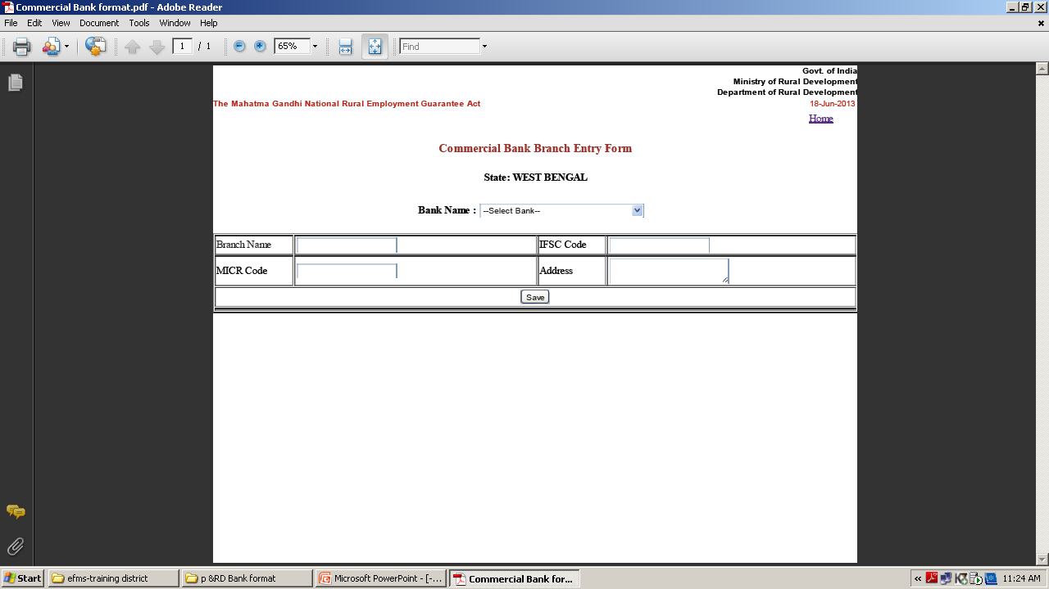
BRANCH NAME OF COMMERCIAL BANK IS MISSING IN MIS, THEN SEND US THE PRESCRIBED FORMAT

Slide 8
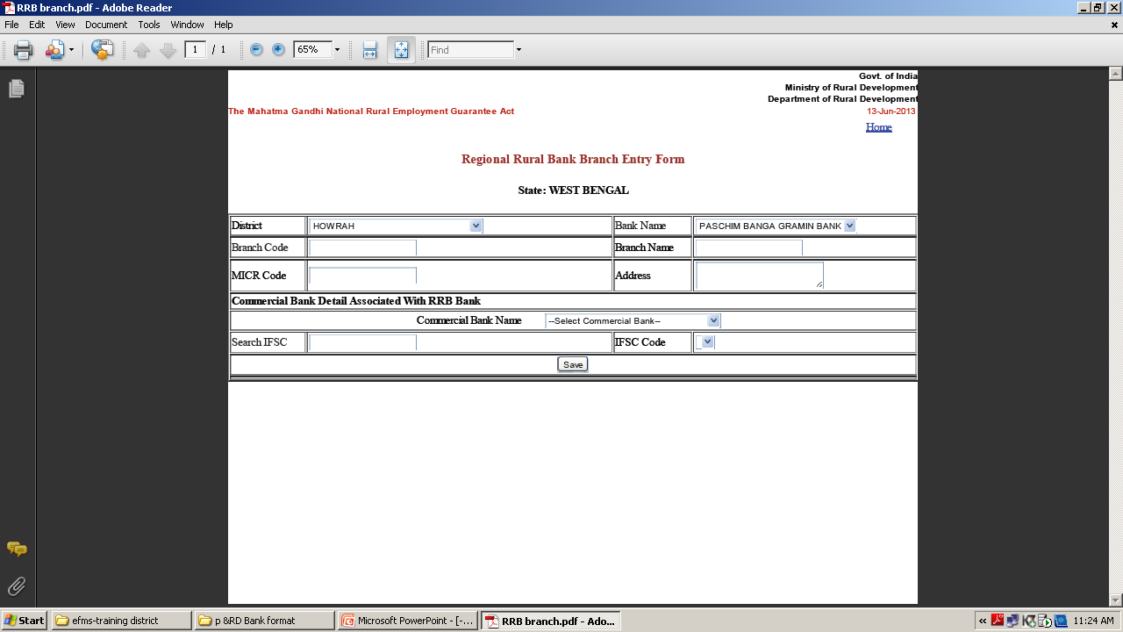
BRANCH NAME OF RRB BANK IS MISSING IN MIS, THEN SEND US THE PRESCRIBED FORMAT

Slide 9
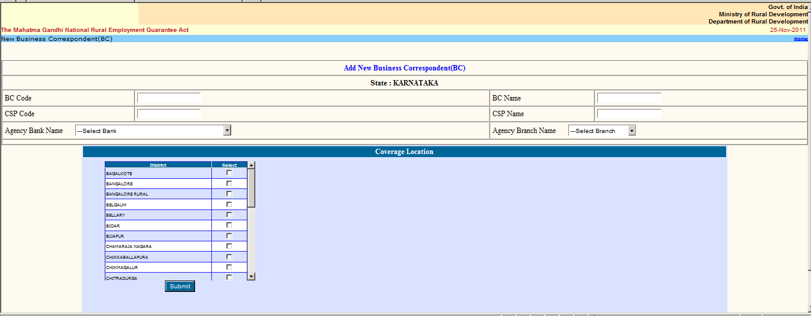
B.C. (Business Correspondent) IS NOT FOUND SENT US THE INFORMATION OF BC MODEL DETAILS.

Slide 10
STEP OF e-ELECTRONIC FUND MANAGEMENT SYSTEM(efms)
ENTER OF ACCOUNT DETAILS OF JOB CARD HOLDER
Updation /verification & Freezing of bank accounts of Job card holder.

Slide 11
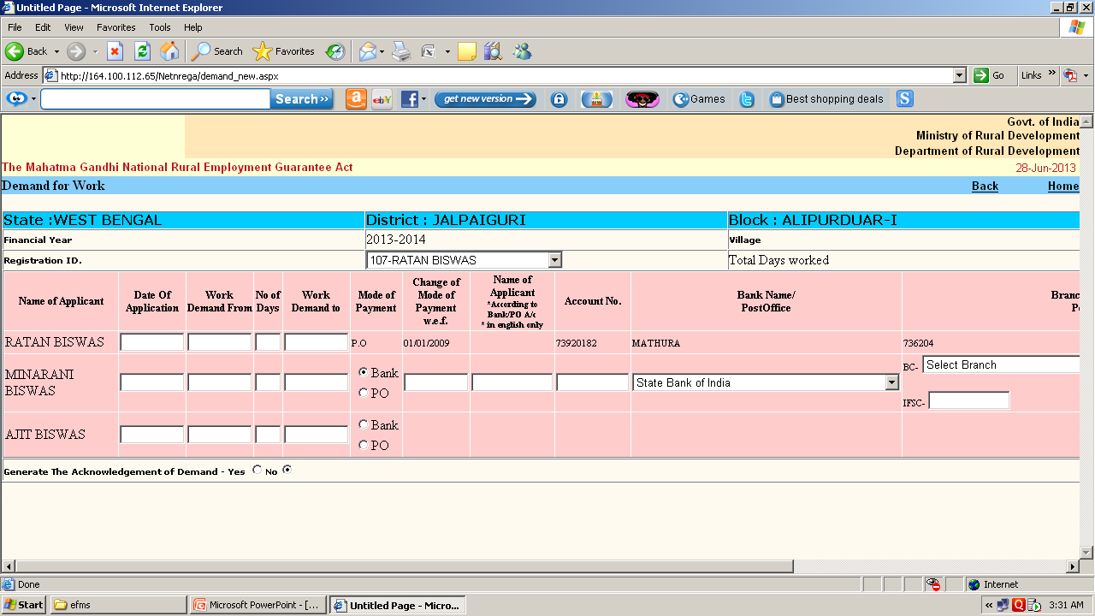
ENTERING OF ACCOUNT DETAILS OF NEW WORKER
Data Entry Operator of NREGASoft are entering account details of each worker demanding for work under MGNREGA.

Slide 12
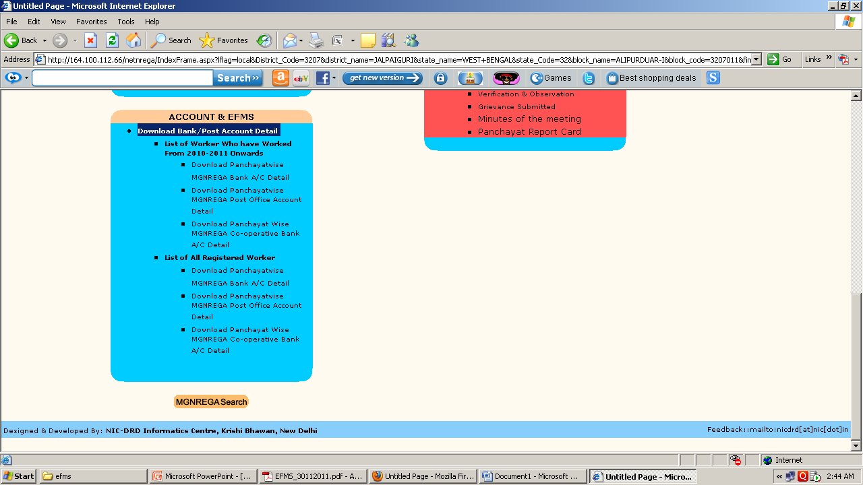
DOWNLOAD THE PANCHAYATWISE ACCOUNT INFORMATION
The account detail can be downloaded from site nrega.nic.in from location
nrega.nic.in -> click on you state (like WEST BENGAL) -> click on district (like JALPAIGURI) -> click on Block (like ALIPURDUAR-I)-> click on panchayat (like PURBA KANTHALBARI ) -> Download Bank/Post Account Detail (Under heading Accounts & EFMS)

Slide 13
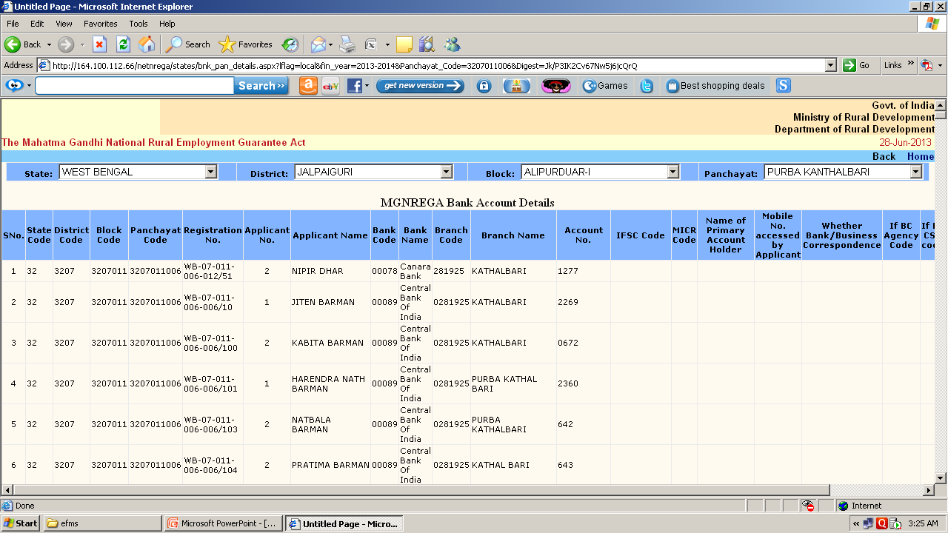
The following screen will shown and at end of this report there is link Download In Excel .Download the information and send it to update.

Slide 14
Take hard copy and correct/collect the information for account_no, IFSC code, Name as per details etc.
updated with the following details
a) Bank Name
b) Bank Code
c) Branch Name
d) Branch Code
e) IFSC Code
f) Bank account(CBS account)
g) Worker name as per Bank

Slide 15
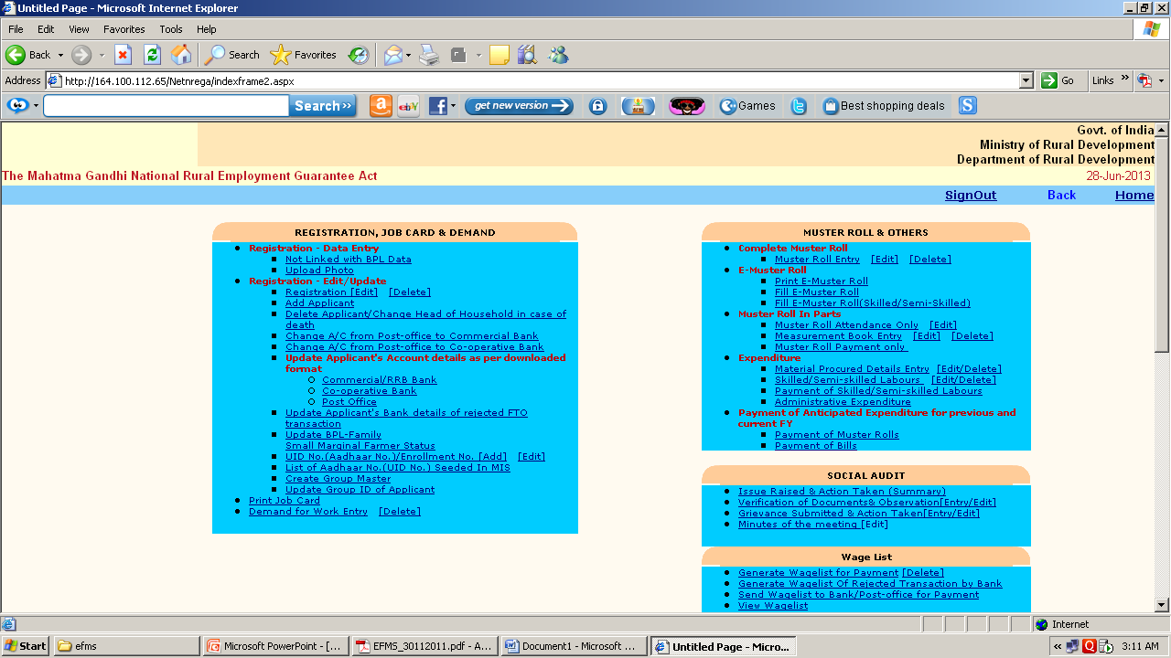
Update the worker account
In G.P (GRAM PANCHAYAT) login the account updating option is there in the format as you downloaded in the above step.
Login from GRAM PANCHAYAT login and use the option Update Applicant's Account details as per downloaded format

Slide 16
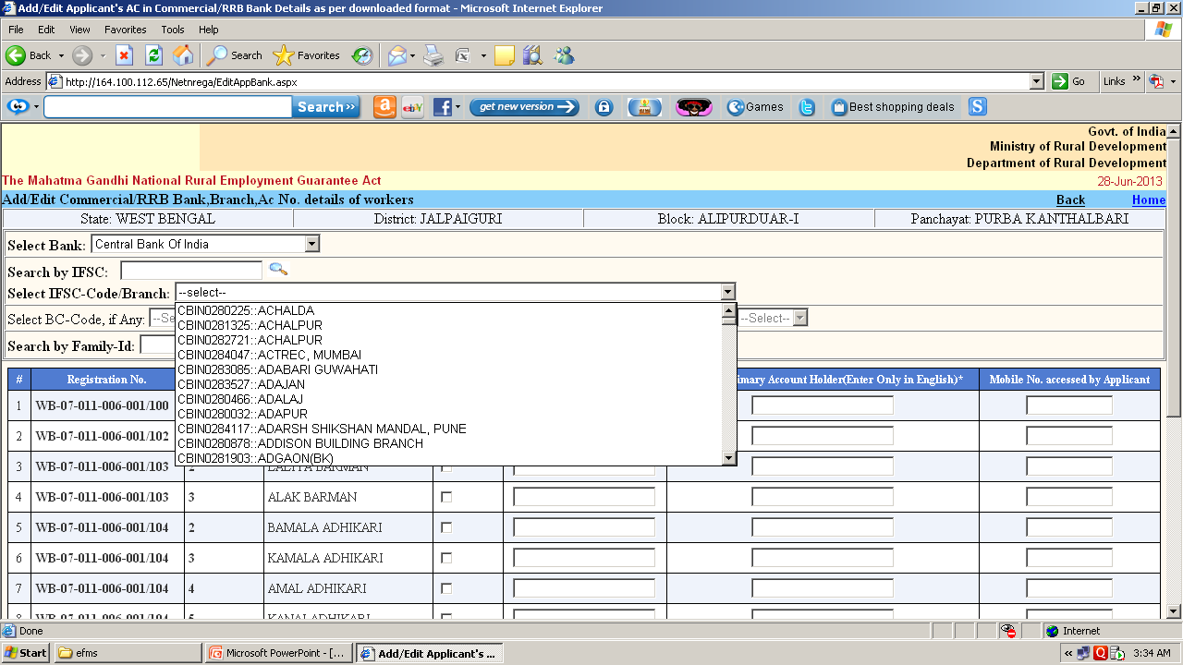

Slide 17
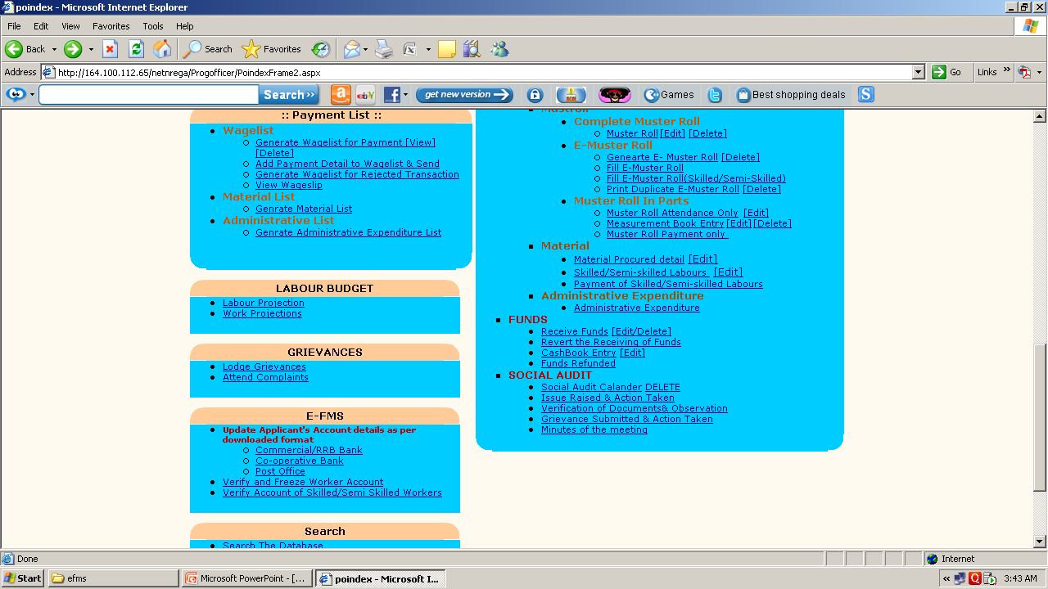
Freeze Worker Account :
Programme officer Login has been provide with the option “freeze workers account” in their data entry page to freeze the accounts. Only freezed accounts can participate in eFMS.

Slide 18
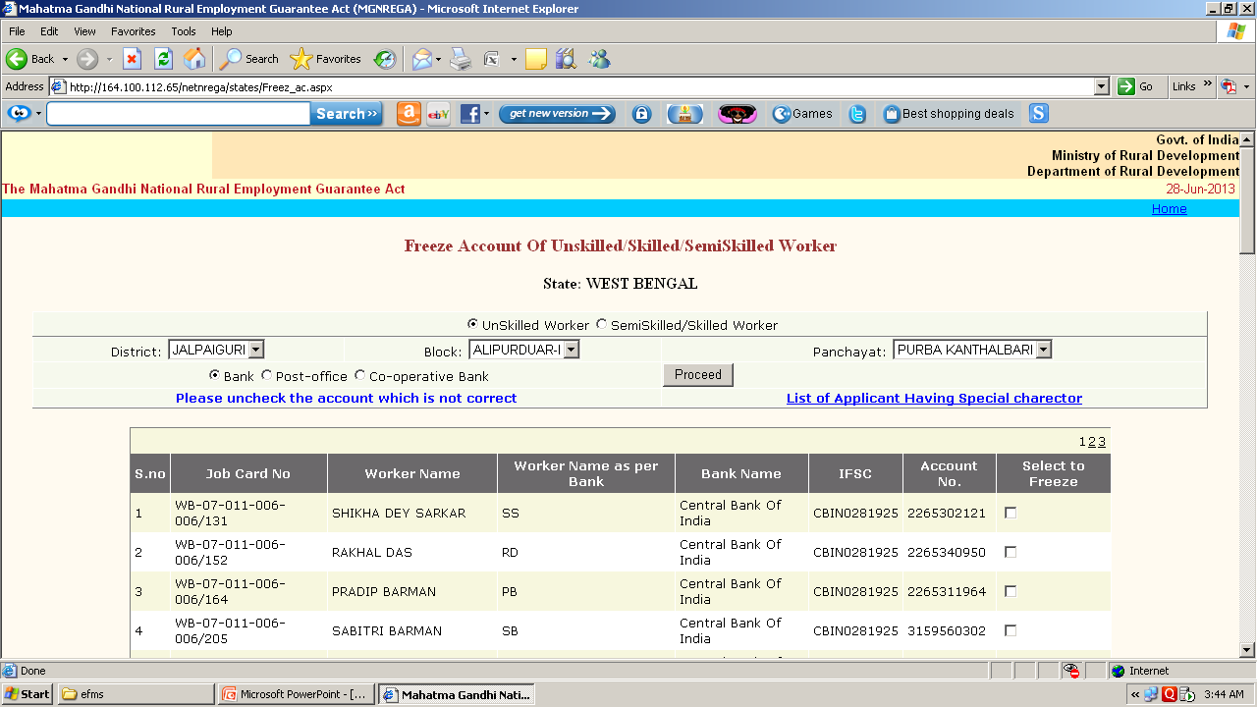

Slide 19
STEP REQUIRED FOR E-FMS
ACCOUNT DETAILS ENTRY OF BENIFICIERIES THROUGH DEMAND MODULE
COLLECTED COPY FOR CHECKING (BANK_NAME, BANK_CODE, BRANCH_NAME, BRANCH_CODE, IFSC_CODE, BANK_ACCOUNT(CBS ACCOUNT), WORKER NAME AS PER BANK) THROUGH -> REPORT SECTION OF GRAM PANCHAYAT MODULE.
COLLECTED AND CORRECTED HARD COPY AS PER DOWNLOAD FORMAT
UPLOAD THE CORRECTED INFORMATION OF BENIFICIERIES ACCOUNT DETAILS THROUGH -> GRAM PANCHAYAT DATA ENTRY LOGIN.
ACCOUNT OF THE BENIFICIERIES SHOULD BE FREEZED FROM PROGRAMME OFFICER MODULE AFTER THAT TO MEET THE E-FMS PROCESS.

Slide 20
DEMAND FOR WORK FROM GRAM PANCHAYAT LOGIN
WORK ALLOCATION FROM GRAM PACHAYAT LOGIN FOR EVERY PIA
GENERATED E-MUSTER ROLL FROM P.O MODULE
FREEZE ACCOUNT TO MEET EFMS
WAGES PAYMENT TO WORKER ACCOUNT THROUGH POST OFFIC E AND BANK
RETURN E-MUSTER ROLL FROM WORK PLACE AT PIA
CHEQUE
FILL E-MUSTER ROLL WITHOUT PAYMENT DATE
GENERATED WAGES LIST

Slide 21
E-MUSTER ROLL AND MEASUREMENT BOOK ENTRY

Slide 22
PRE-REQUISITE FOR E-MUSTER ROLL
E-Muster roll can be generated one month in advance. (Muster roll from date should not be more than 31 days from the current Date.)
Worker should be allocated to the work for the e-Muster roll period.
e-Muster period should not be greater then 16 days.

Slide 23
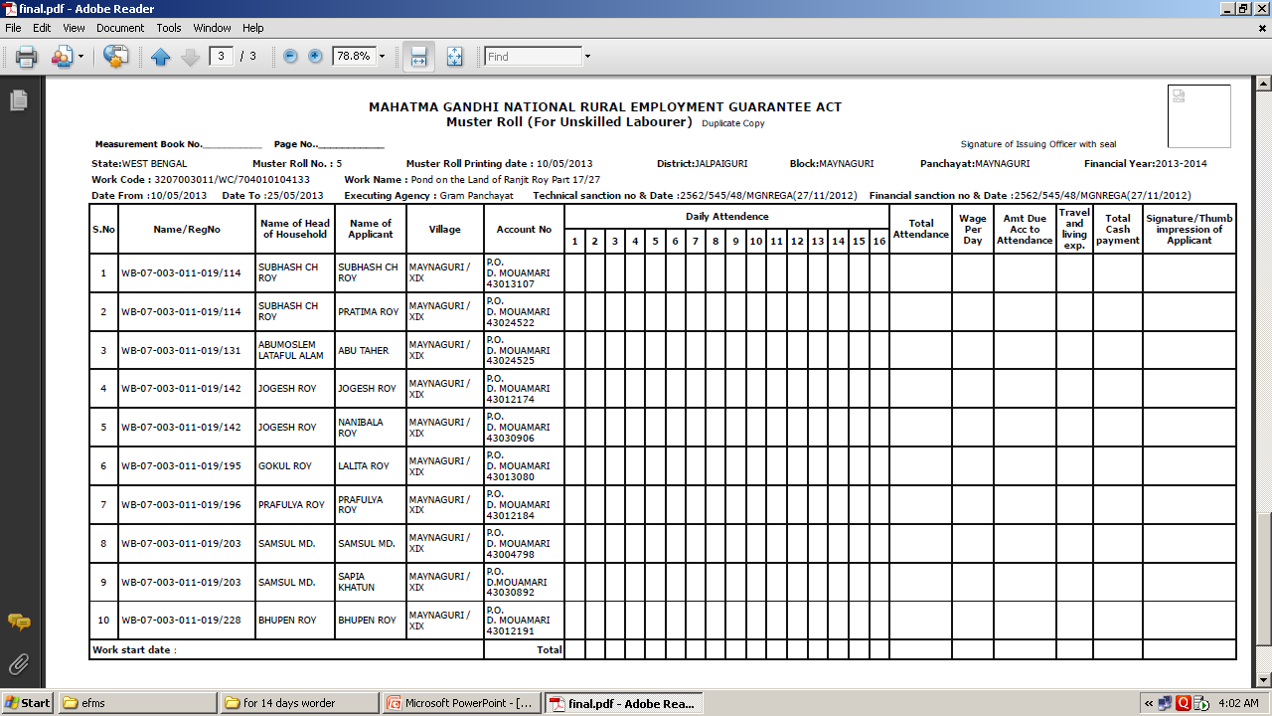
PRINT : E-MUSTER ROLL

Slide 24
FILLED E-MUSTER ROLL
Generated E-Mustroll where To date is less than the current date can be filled.

Slide 26
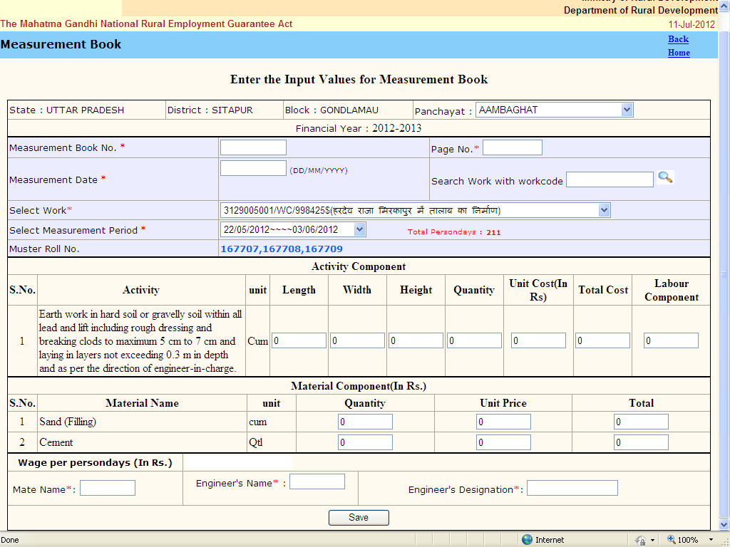
ENTRY OF MEASUREMENT BOOK

Slide 27
GENERATED WAGES LIST FOR PAYMENT

Slide 28
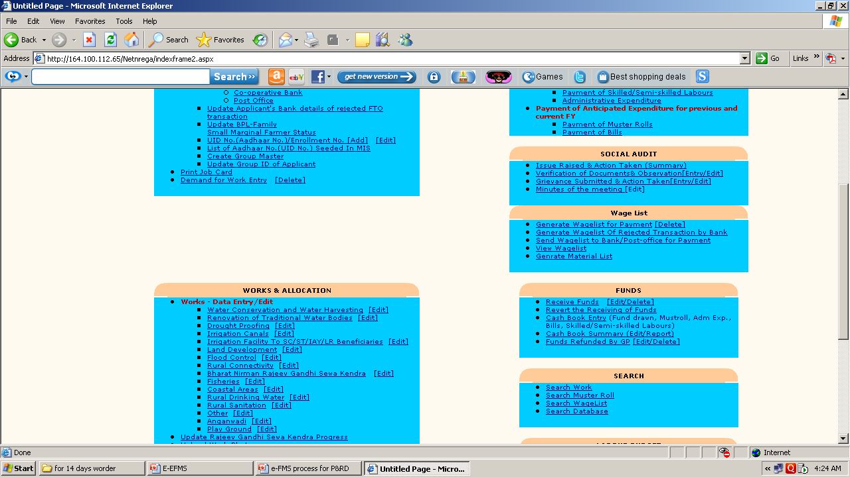
Generated wage list for payment link

Slide 29
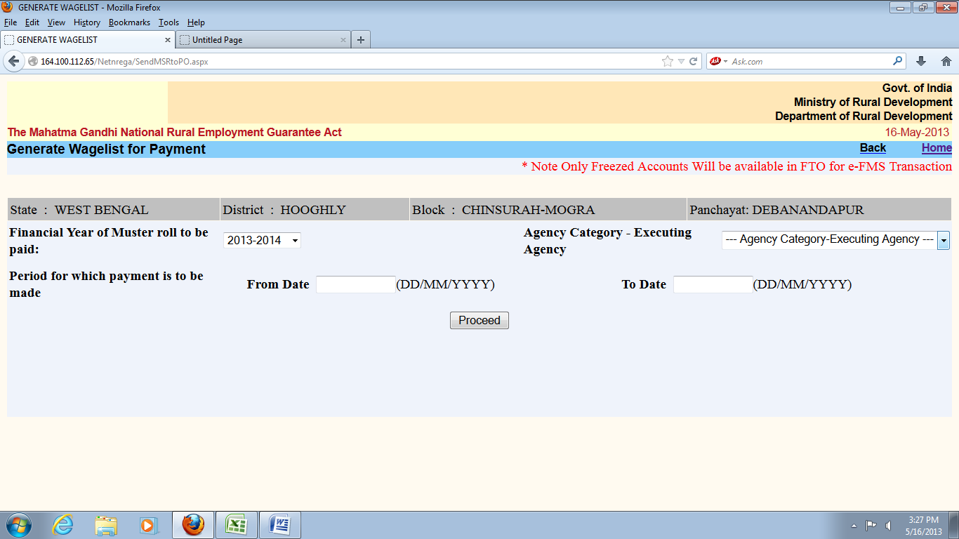
WAGES LIST GENERATED PROCEDURE
Muster roll without payment date can participate in generation of wage list
Generate the wage list
C. Separate Wage list will be generated for
i. One for each bank branch
ii. One for each sub post office

Slide 30
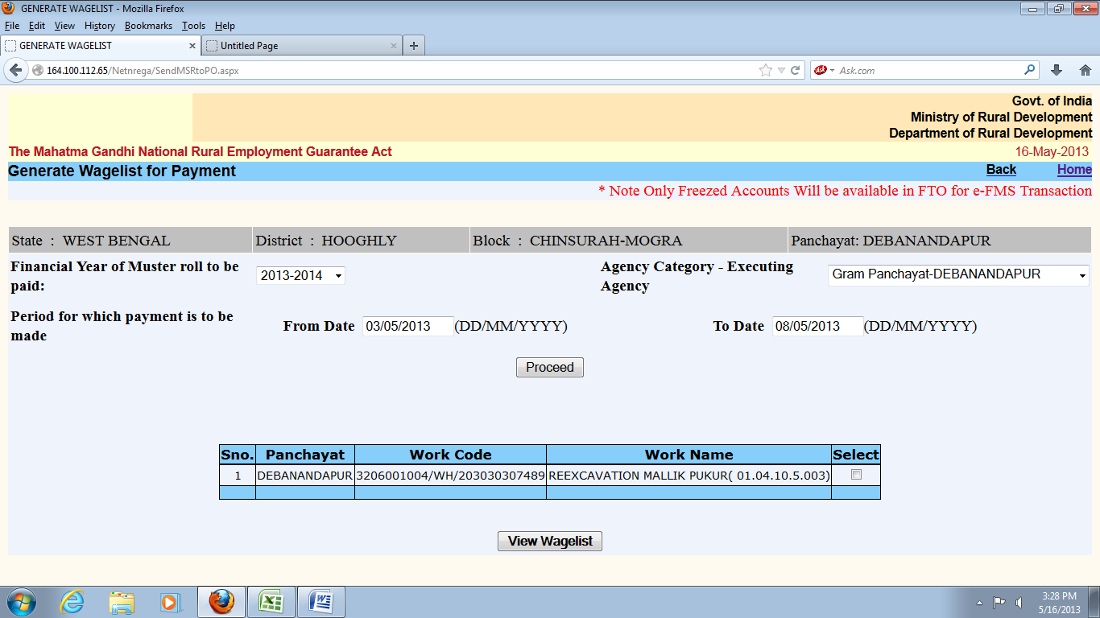

Slide 31
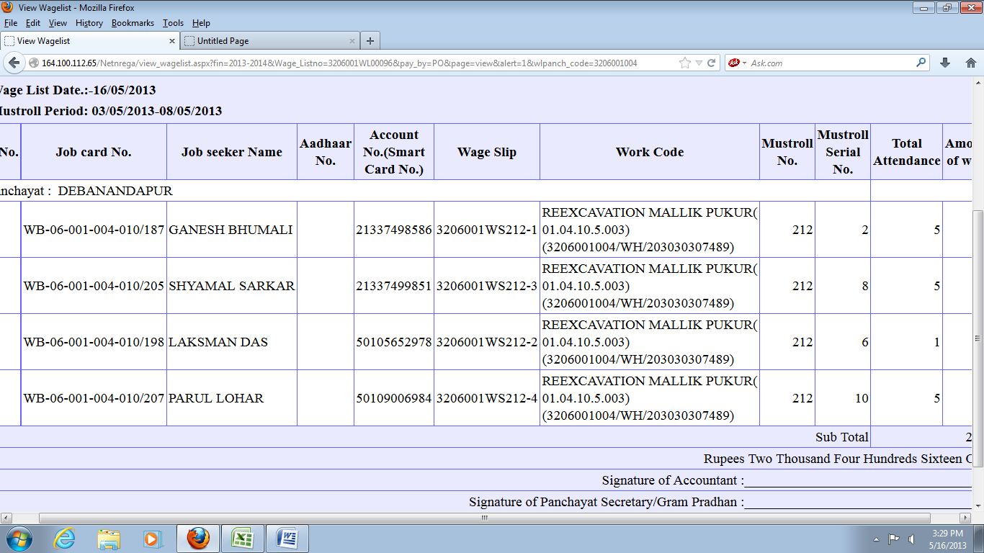

Slide 32
e-FMS
(Electronic Fund Management System)

Slide 33
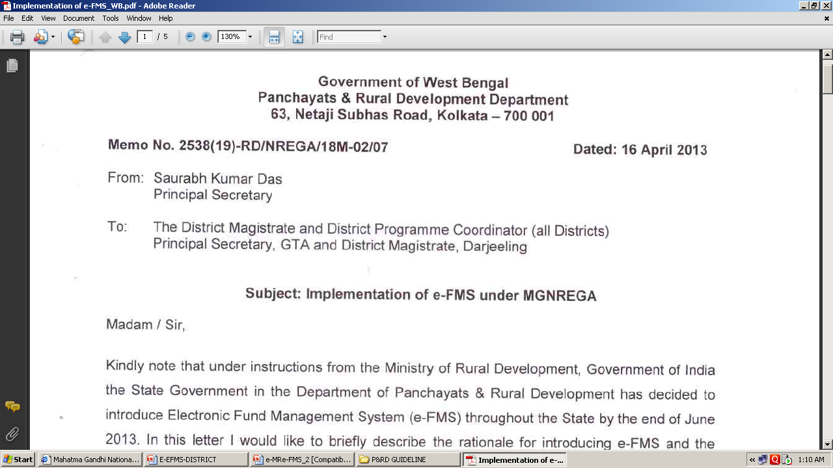

Slide 34
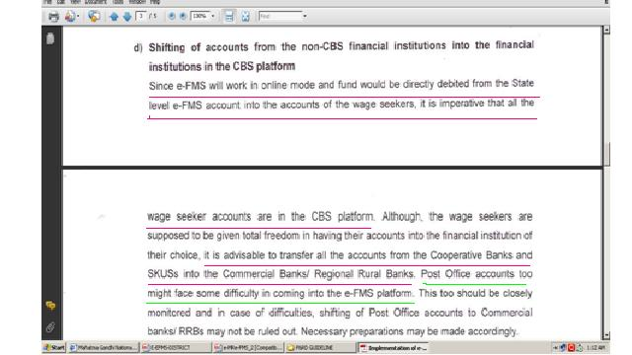

Slide 35
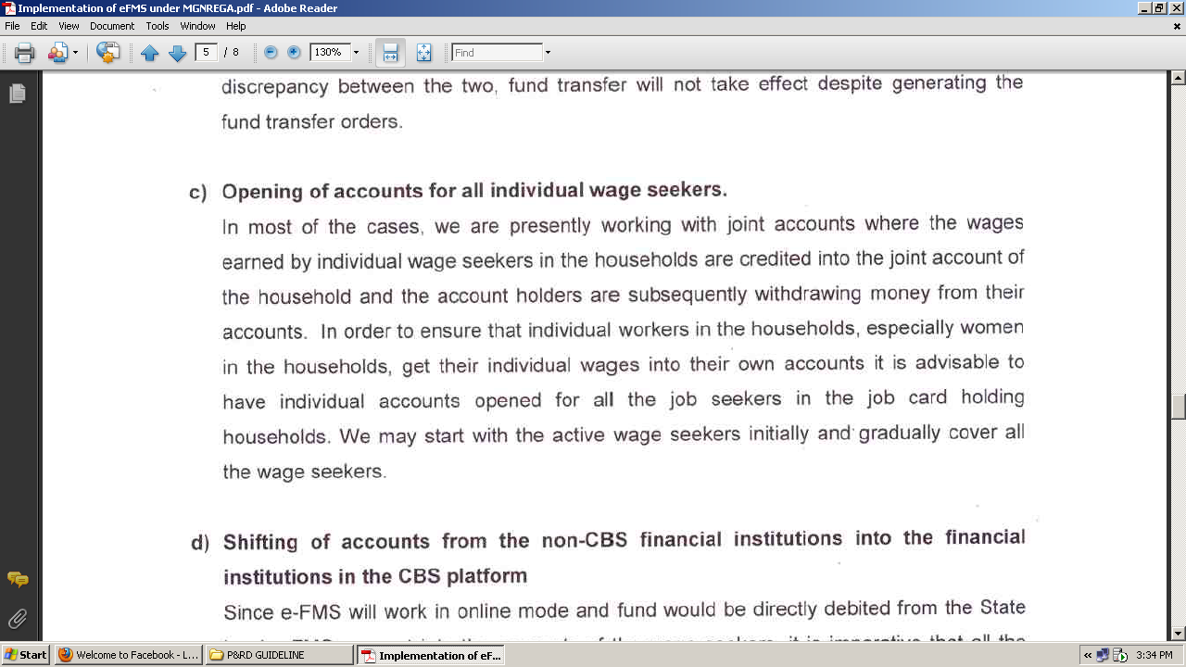

Slide 36
DIGITAL SIGNATURE CERTIFICATE REQUEST FORM
GUIDE LINE FOR FILLING THE DIGITAL SIGNATURE CERTIFICATE REQUEST FORM

Slide 37
Installation of Digital Signature
Visit the site https://nicca.nic.in
Click the Option “ Download Smart Card /USB e-Token Driver”
Download Star Key/ G&D Safesign Identity-Client (Zip Format)
Extract the Zip file and then in the Star Key folder contains 2 files.
  SafeSign-Identity_Client-3.0.00-32-ADMIN-Full.exe(For 32 bit Machine)
  SafeSign-Identity_Client-3.0.00-64-ADMIN-Full.exe(For 64 bit Machine)
  Check whether your machine is 32 bit or 64 bit by right click the “my computer “ on desktop and then select property->general. If nothing is written then it is 32 bit otherwise system will tell 32 bit or 64 bit
Now attach the DSC token in USB port of the computer.
Also JRE JAVA Software installation.

Slide 38
ENROLLMENT PROCESS FOR DIGITAL SIGNATURES
OPEN THE BROWSER AND GO TO https://nicca.nic.in
SELECT “Member Login” from the Login option
Enter the “user-id” and “password”. User-id is the DSC number given at the right bottom of the card “ G2_WB_xxxxxx” . The user-id and password are same for the first time.
Click Enroll OR Step-1 for generating your Digital Certificate key pairs. ( An electronic form will be displayed that has to be filled as mentioned below and submitted to NICCA)

Slide 39
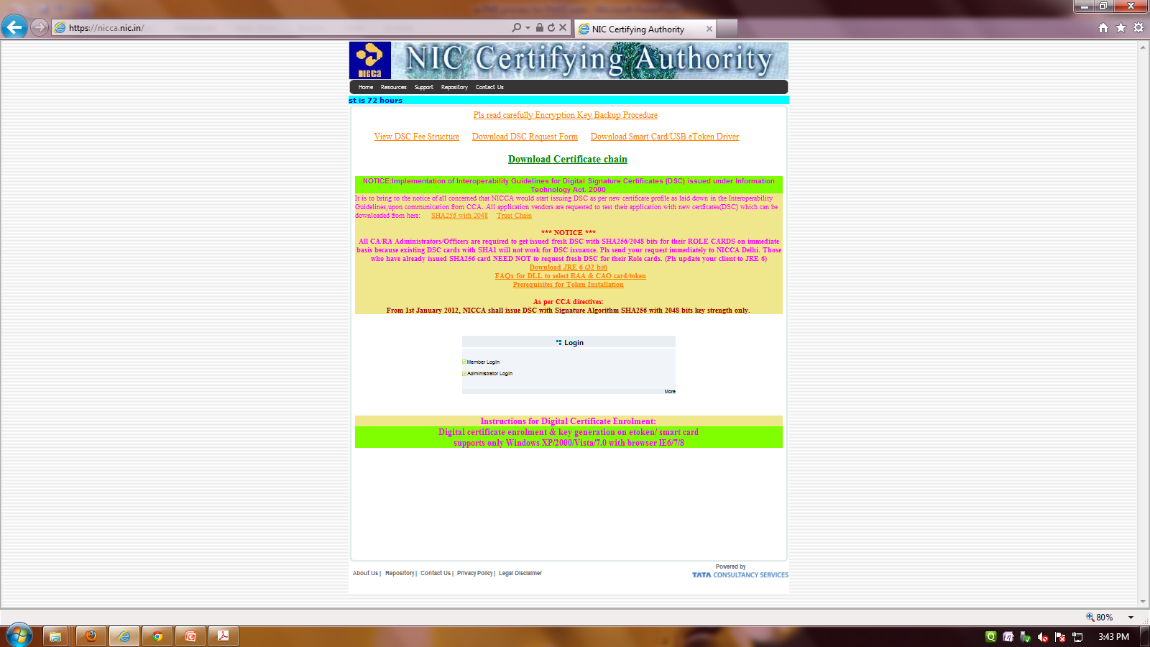

Slide 40
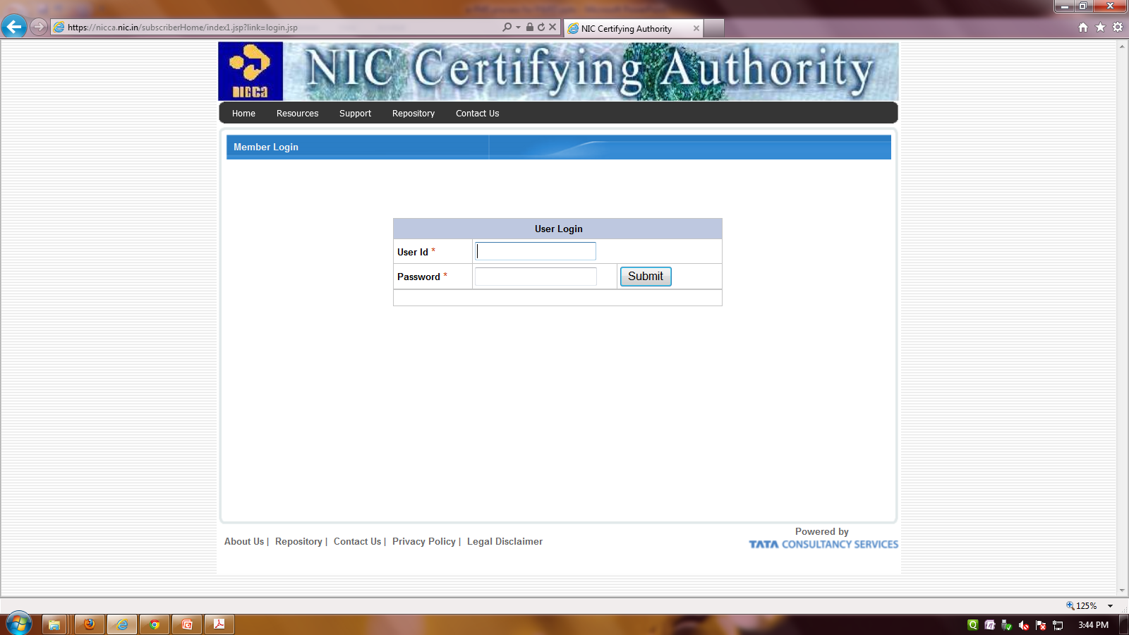

Slide 41
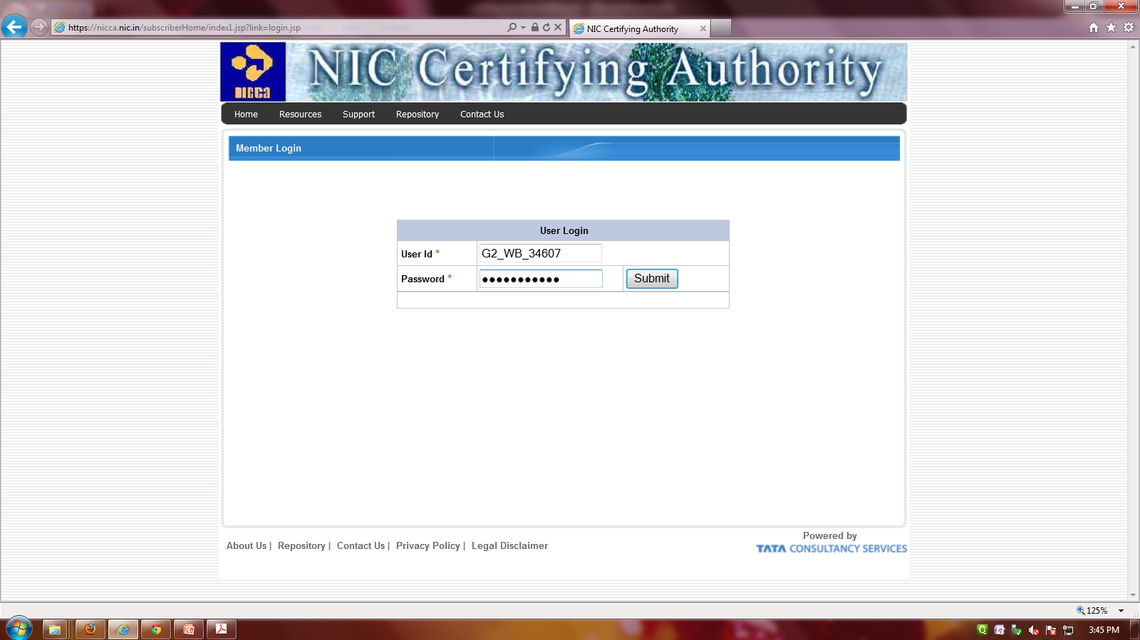

Slide 42
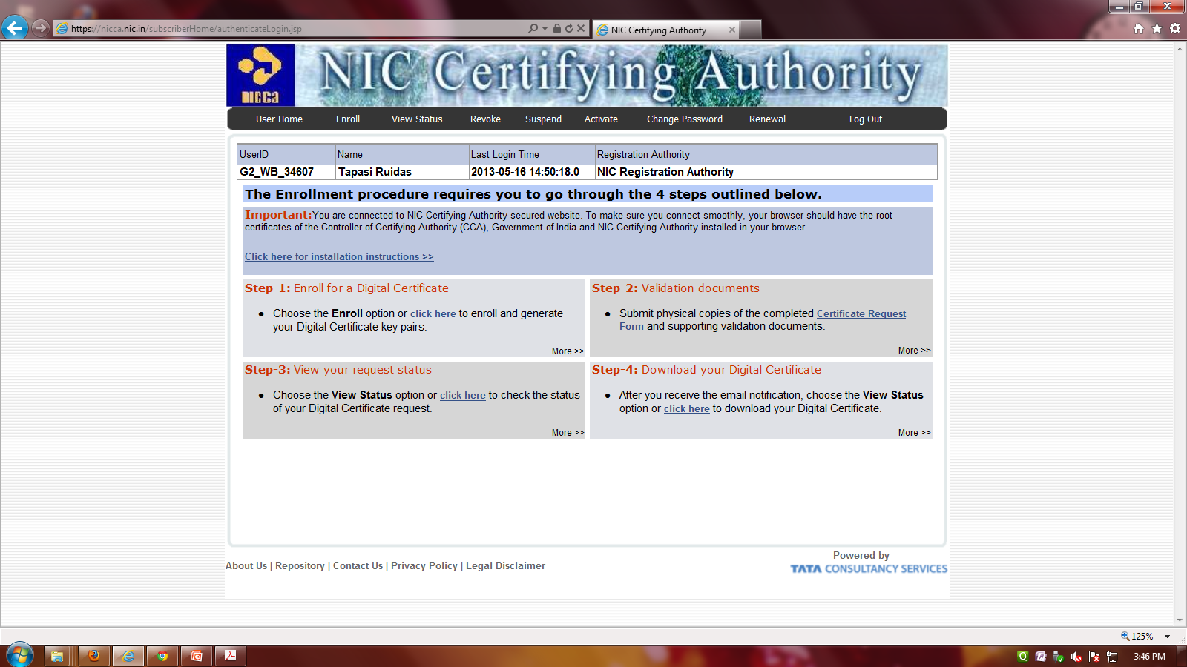
The Enrollment procedure requires you to go through the 4 steps outlined below.

Slide 43
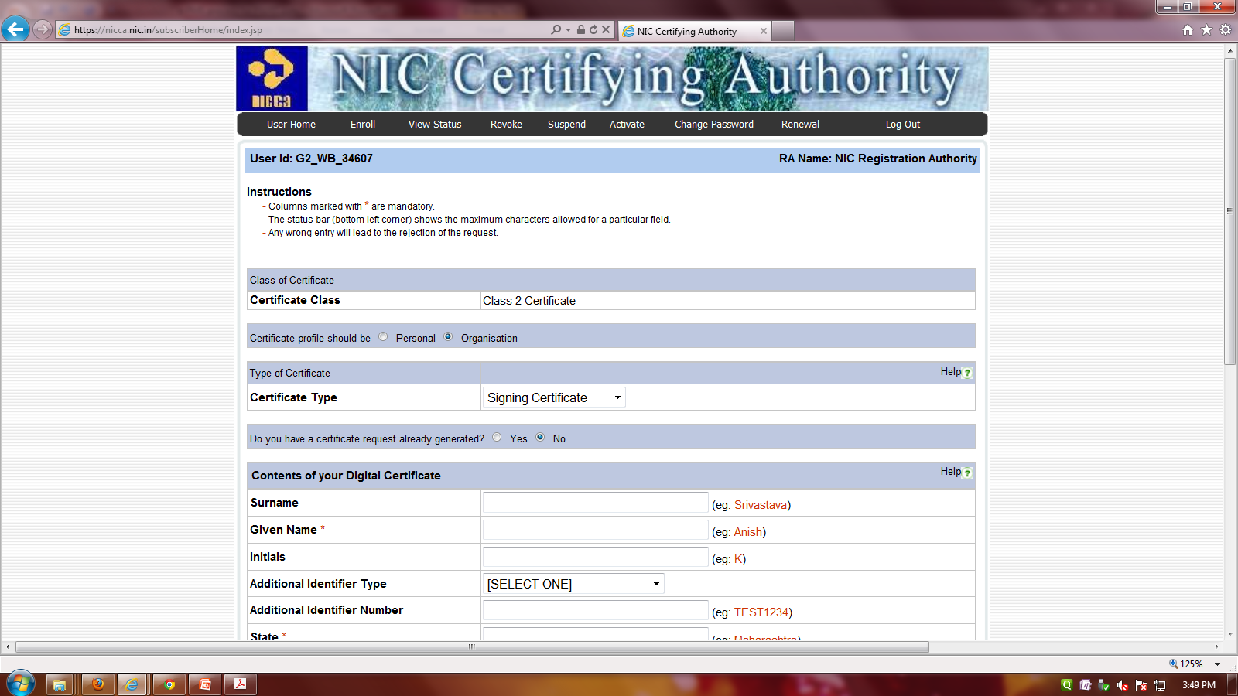
First click the Enroll link. Fill up all details as per DSC Request Form.

Slide 44
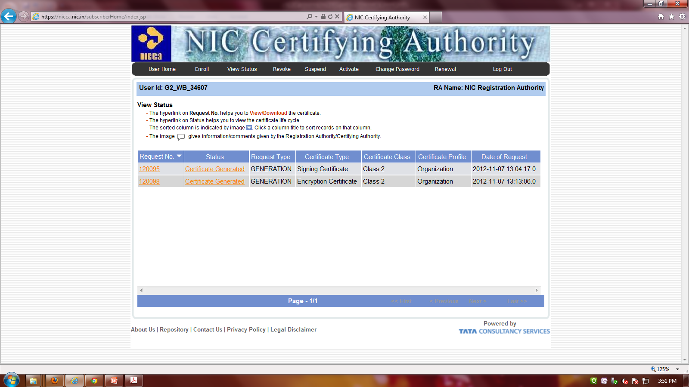
After enrollment the view status in request type will be shown as pending.

Slide 45
Hopefully next day the authentication pin number will send by NICDRD to the User’s mail-id.
After that install the signing certificate into the USB e-token by providing the authentication PIN number.
Download the Encryption Certificate from “nicca“ website and preserve it into the machine for future reference. All the certificates should installed into the DSC e-token.

Slide 46
Installation of Digital Signature
Then go to
Internet Explorer→Tools→ Internet Option → Content Certificate
  It will show your DSC Certificate.
  If Token is shown, now your machine is capable of using DSC Tokens.
  If DSC certificate is NOT shown, then the driver is not installed properly

Slide 47
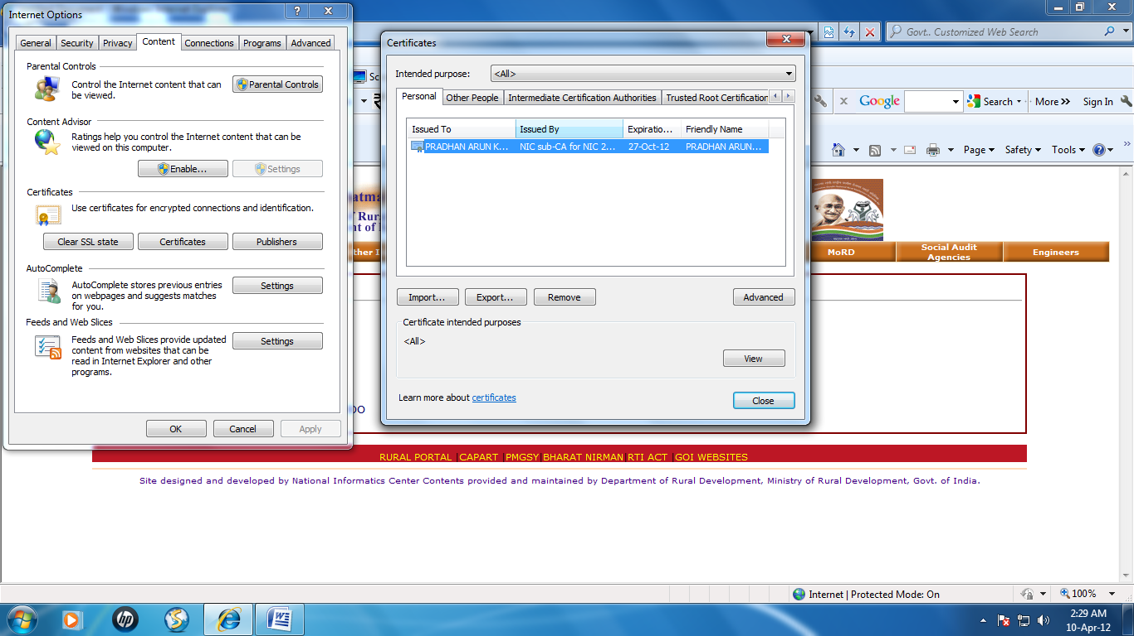

Slide 48
Enrollment of Digital Signature
It is one time process.
To enroll Digital Signature, connect the DSC to USB of the computer.
System will check Java JRE on your machine.
Then “Download Java JRE and Install”.

Slide 49
Contn…..
To enroll new DSC on Your Machine Connect the digital signature USB token to the USB port of your machine.
System will show all available DSC no your Machine Including the One in USB token if USB token is connected to your Machine.
Select the DSC to be used for NREGA e-FMS.
System will check for expiry date of DSC. If expired you have to get it renewed from issuing authority(NIC)
If DSC if valid it will prompt for PIN Number. Enter PIN number. If PIN number is correct you are enrolled in NREGASoft.

Slide 50
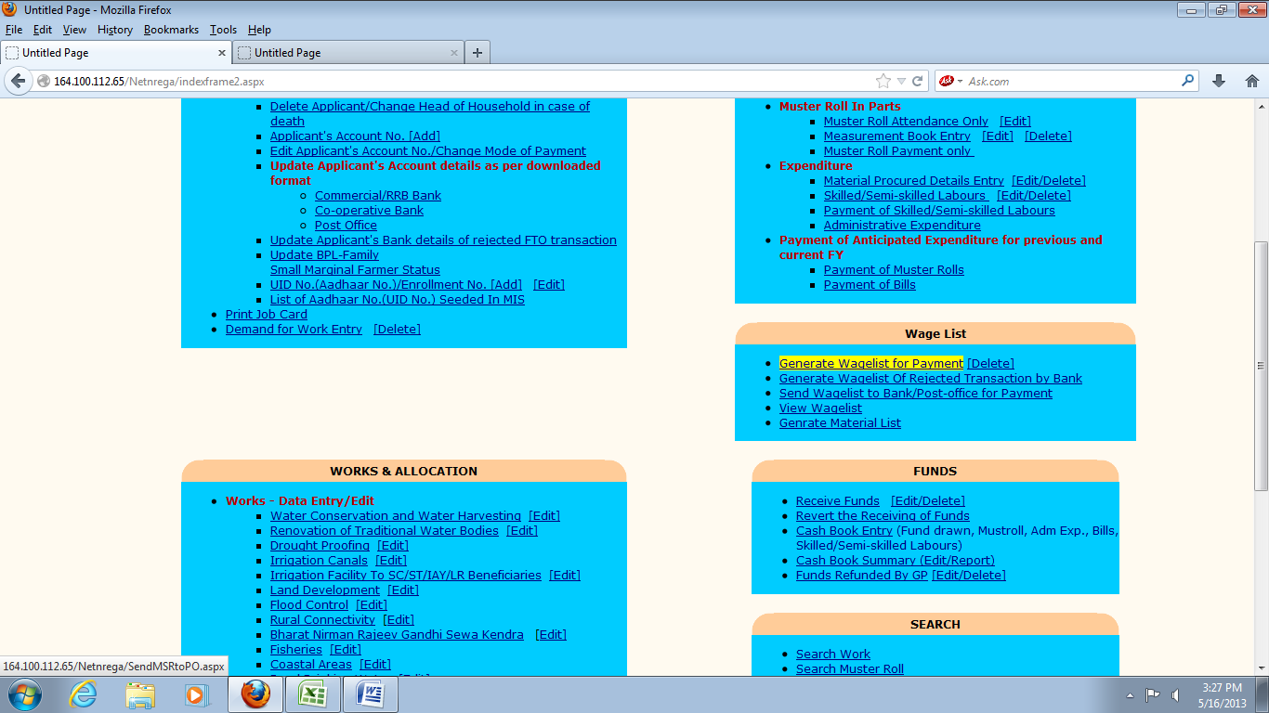
Pre requisites for FTO generation
After work demand & work allocation process, fill up & complete the Muster
Roll entries in National Portal.
Click “Generate Wagelist for payment” link.

Slide 52
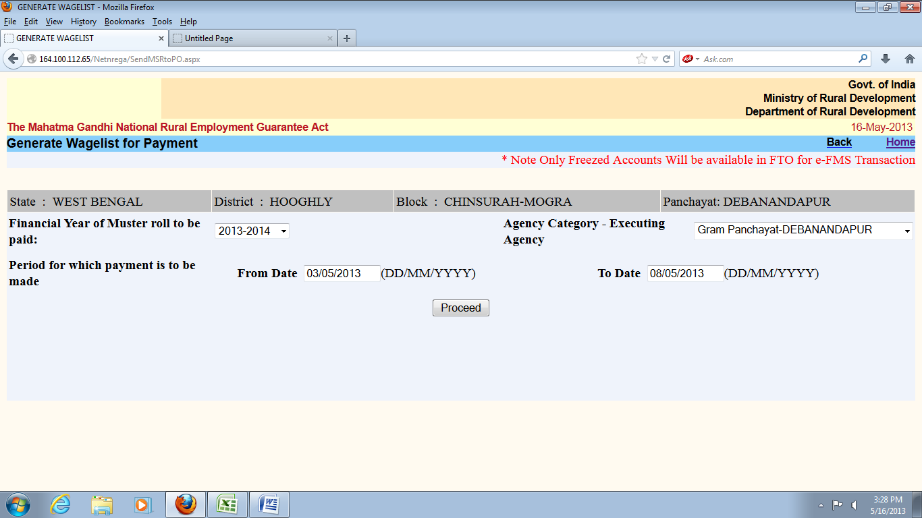
Click Proceed button

Slide 54

Click the Check box and click View Wagelist button to display & view the Wagelist.

Slide 55
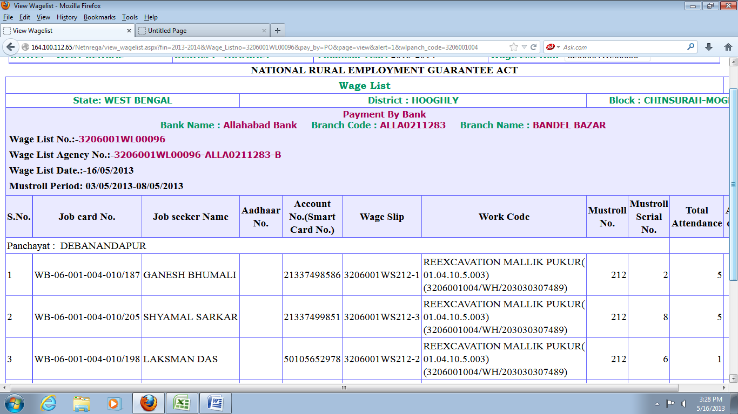

Slide 57

Next click Send Wagelist to Bank/Post Office for Payment

Slide 58
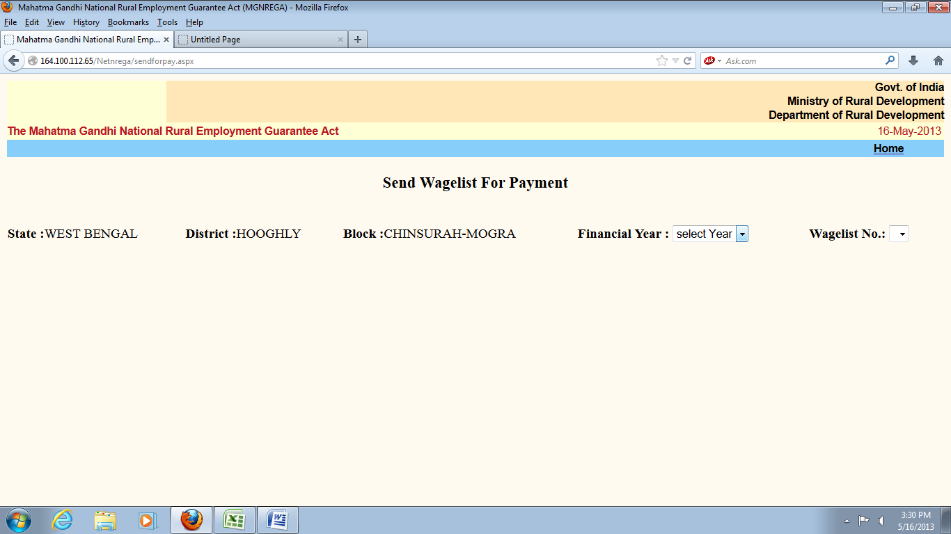

Slide 59
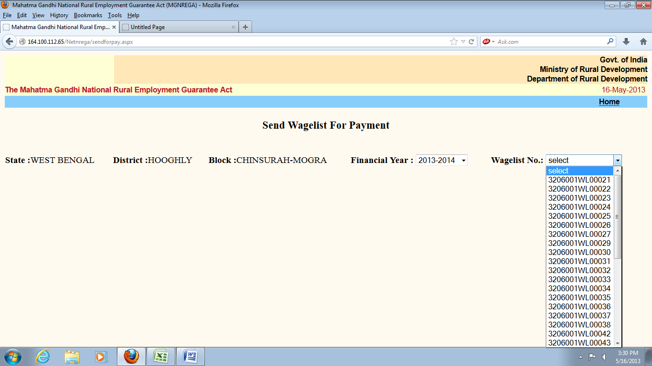

Slide 60
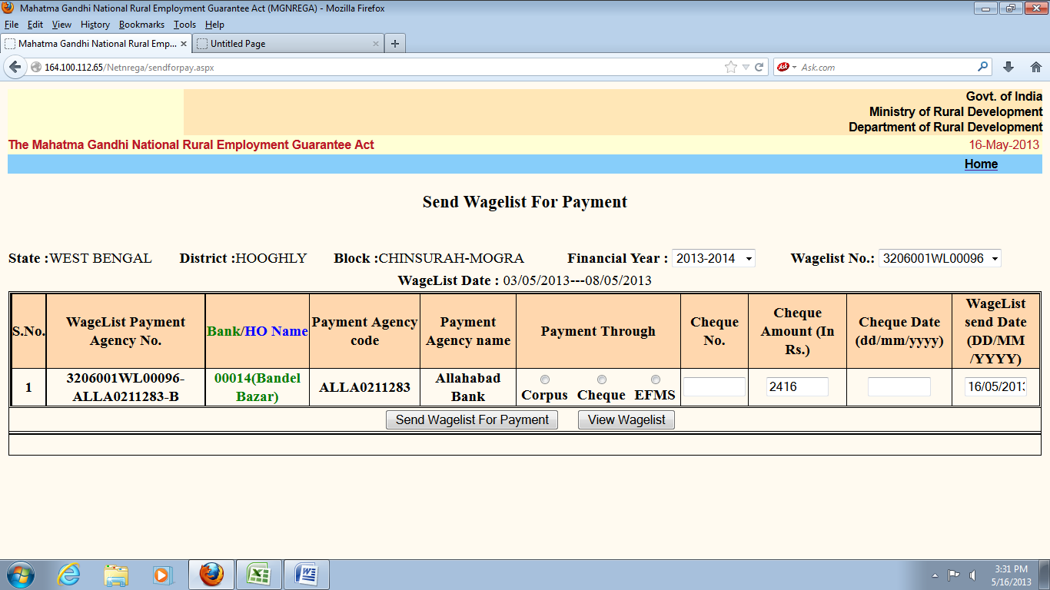

Slide 61
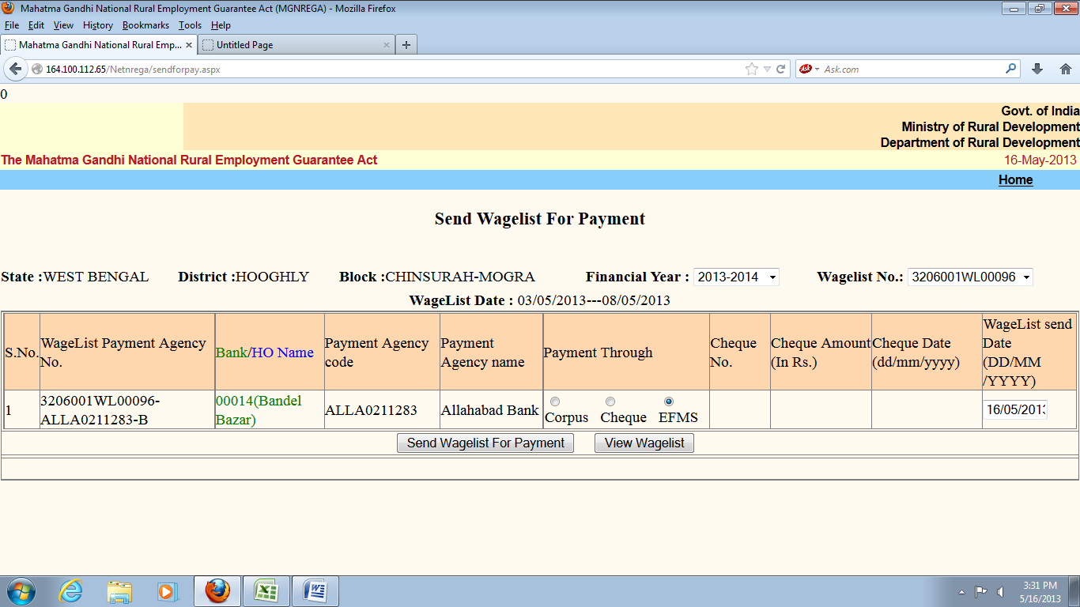
Click EFMS option button & then click Send Wagelist For Payment

Slide 62
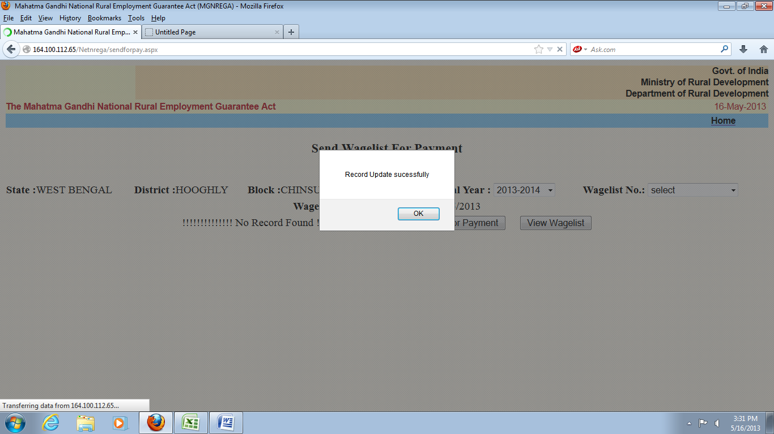

Slide 63
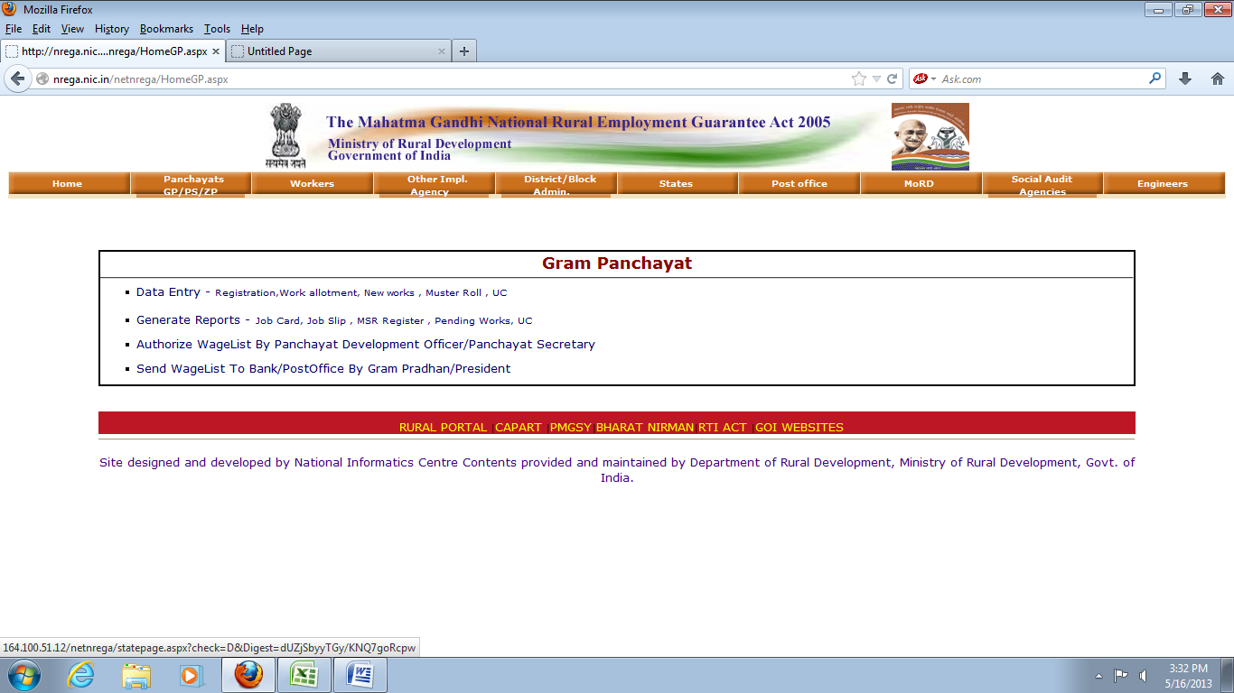
Generation of FTO

Slide 64
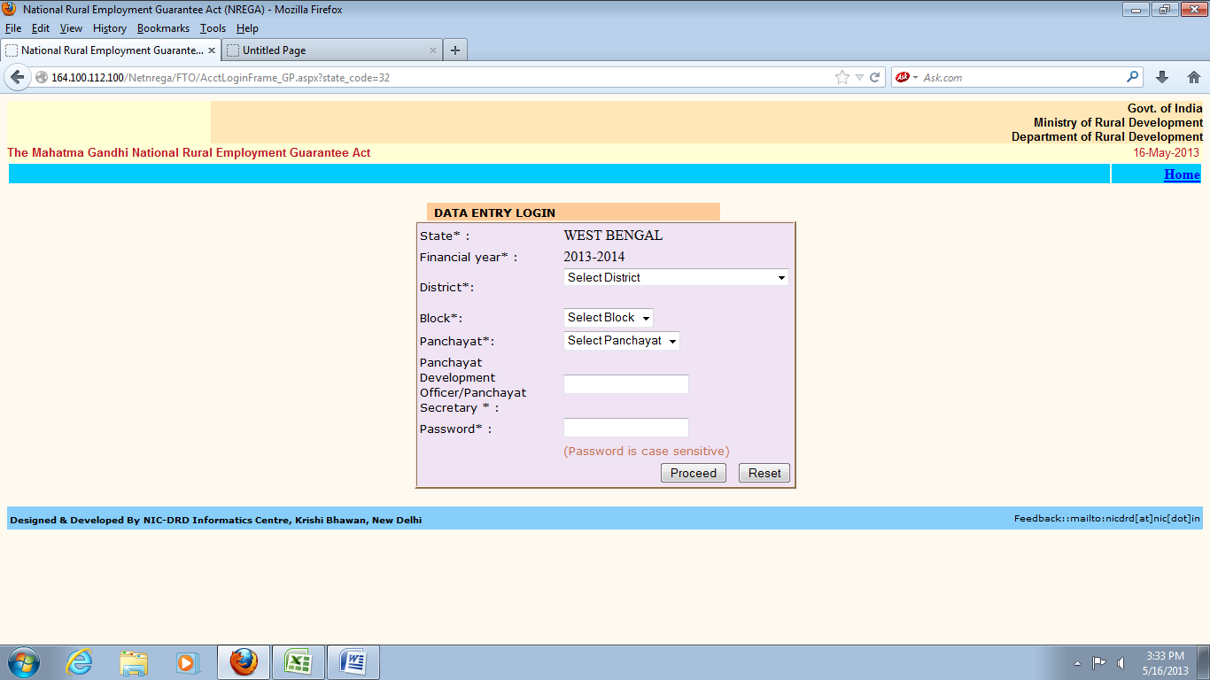

Slide 65
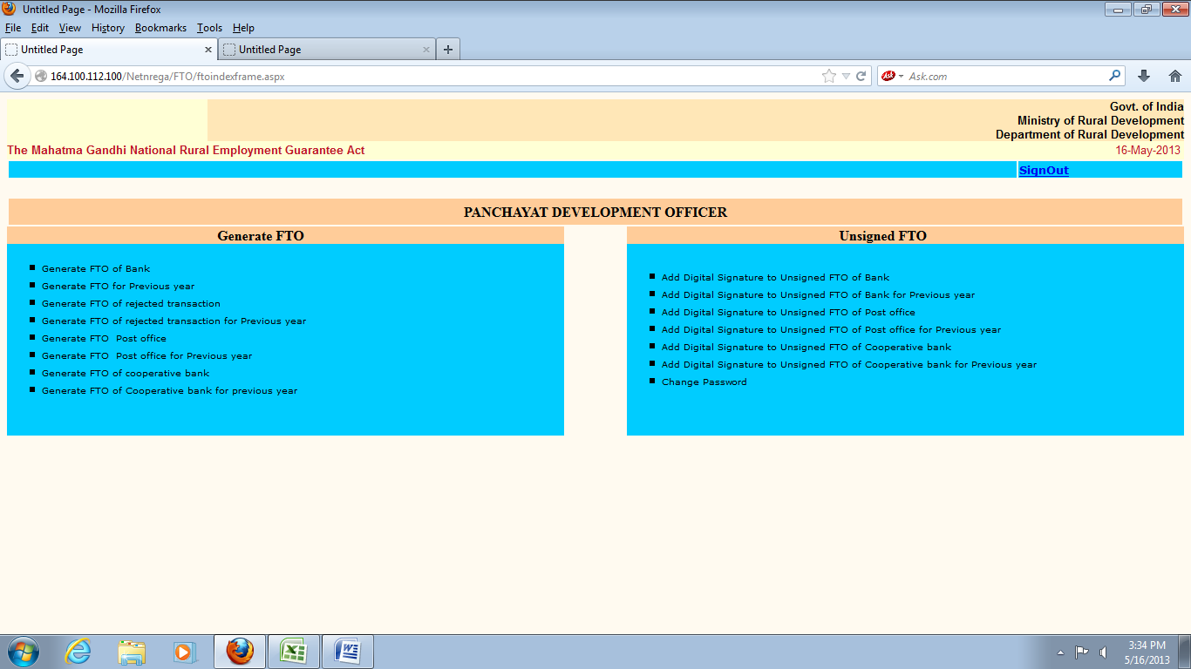

Slide 66
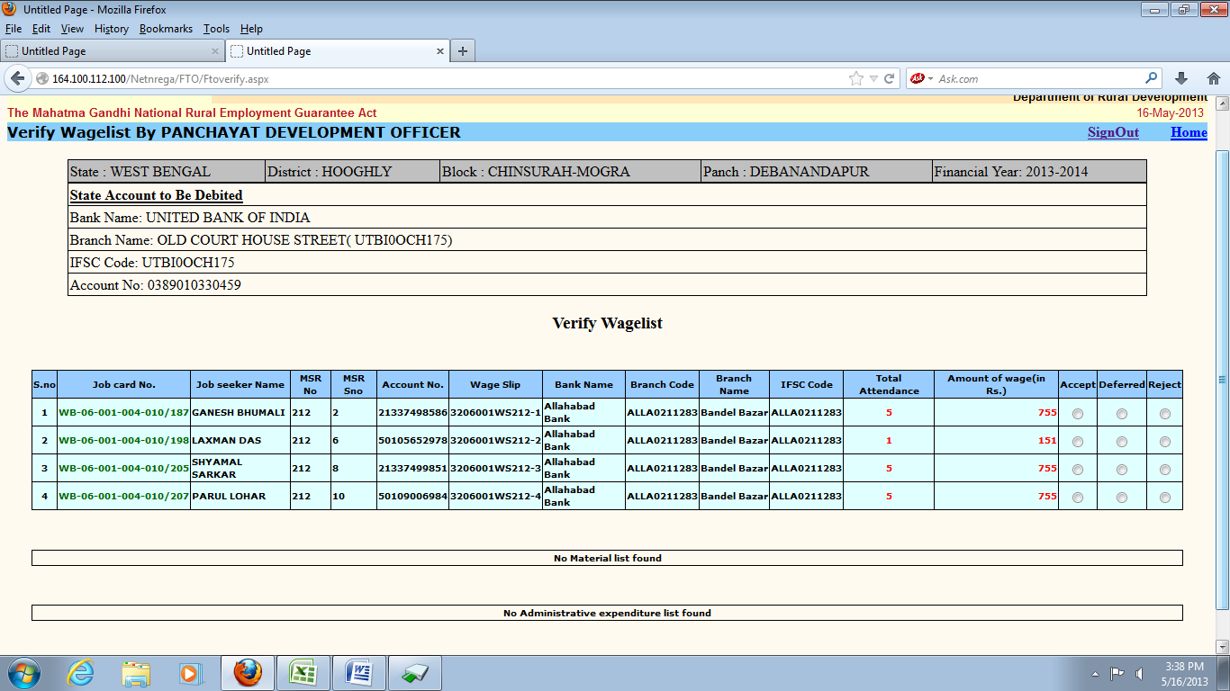

Slide 67
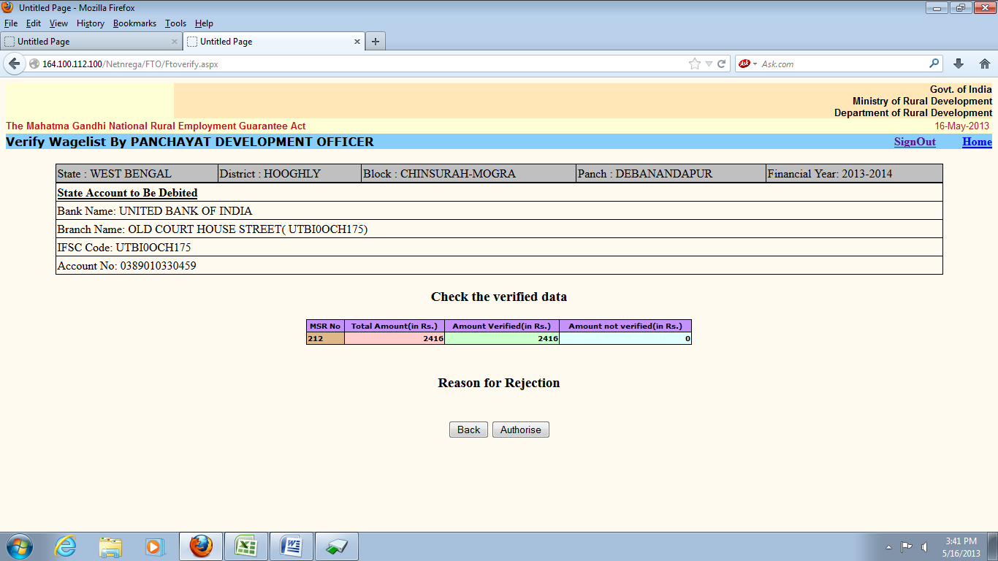

Slide 68
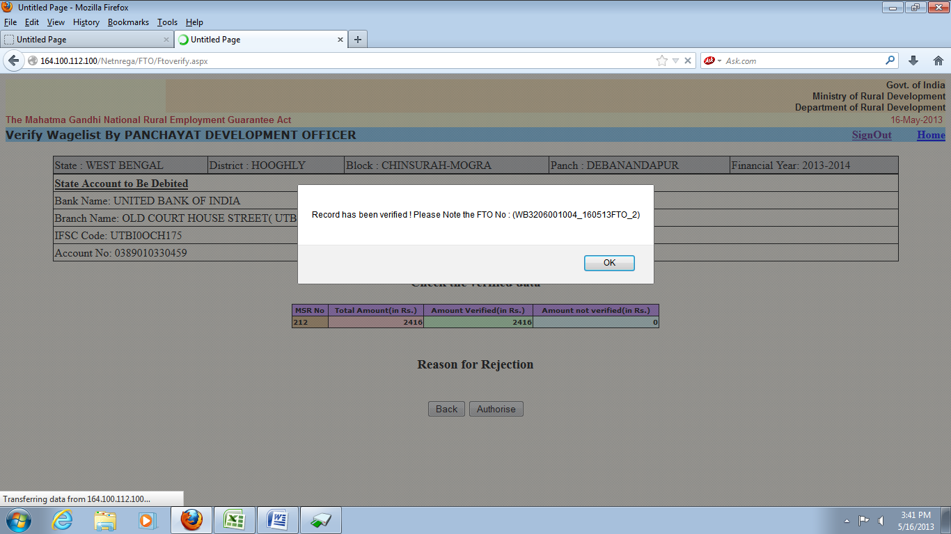

Slide 69
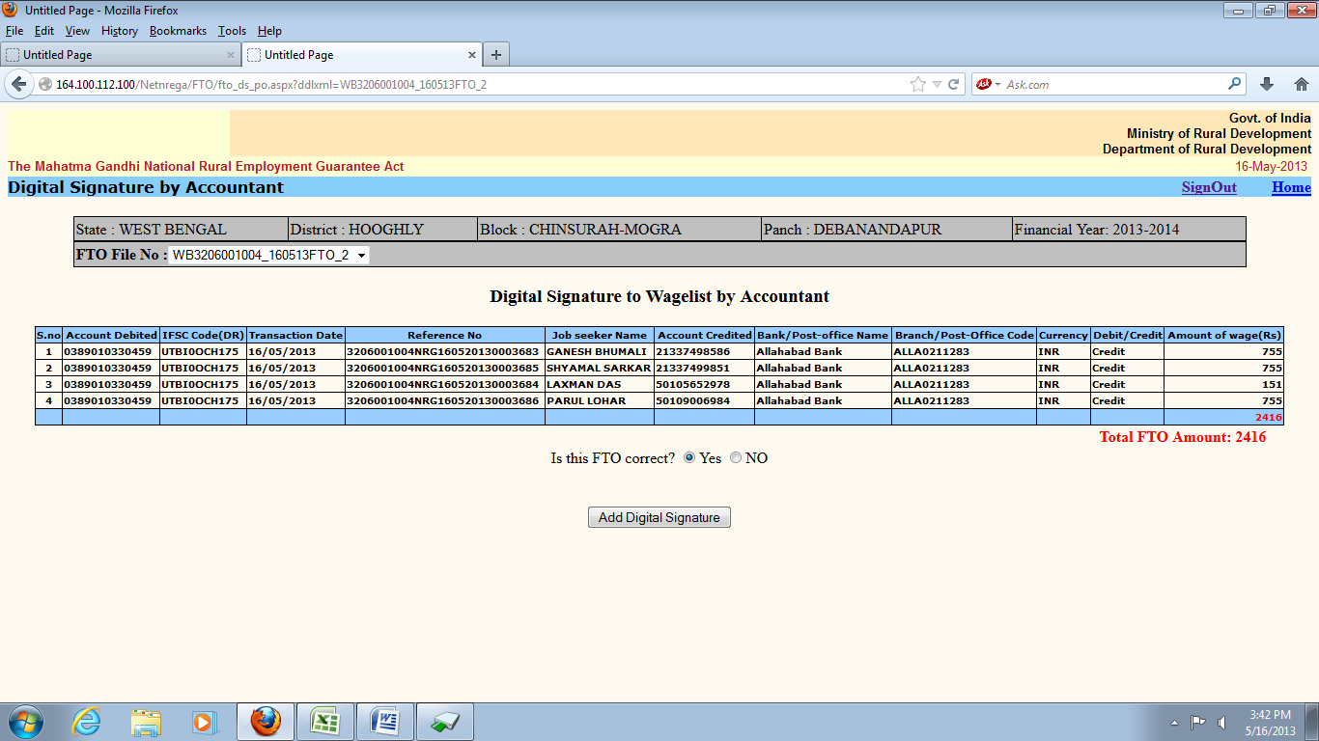

Slide 70
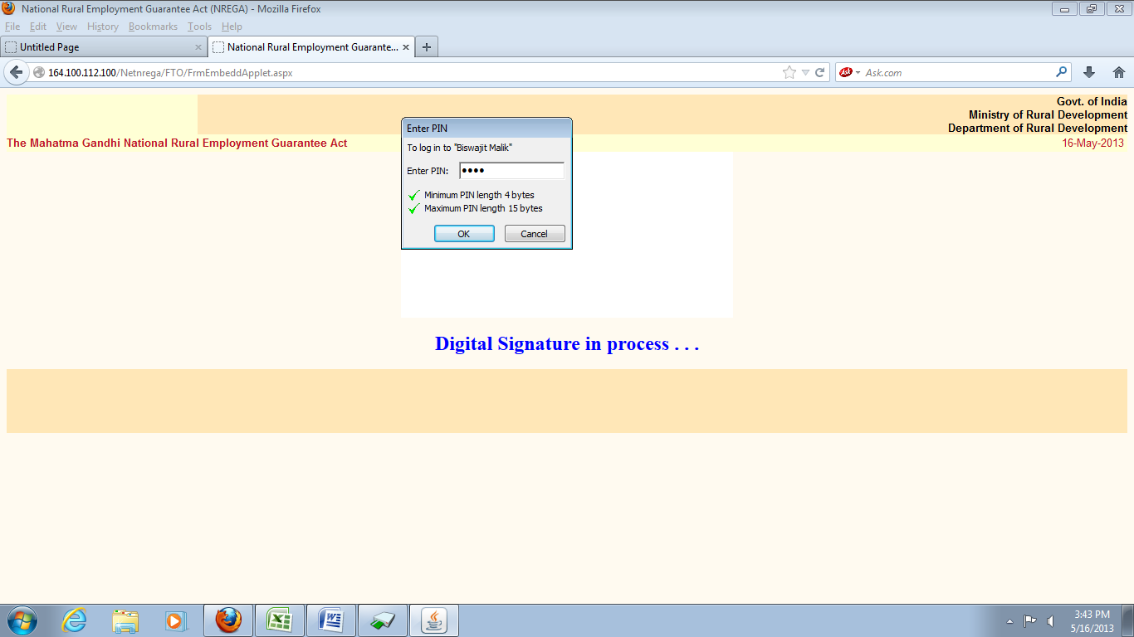
Insert the DSC e-token into USB drive

Slide 71
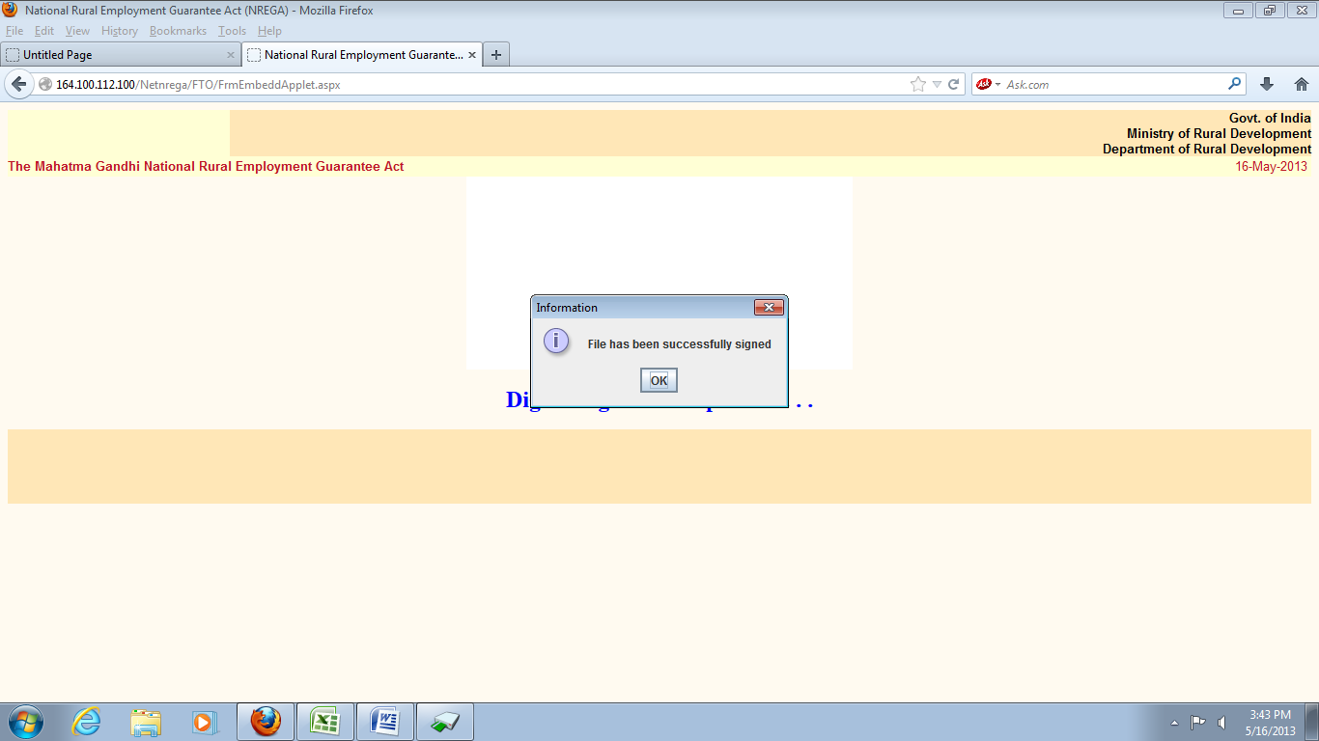

Slide 72
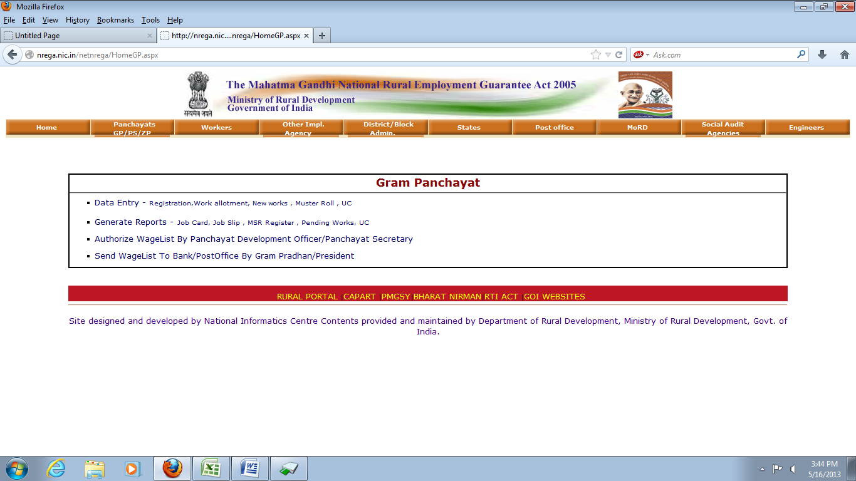
Send Wagelist to Bank/Post Office by Gram Pradhan

Slide 73
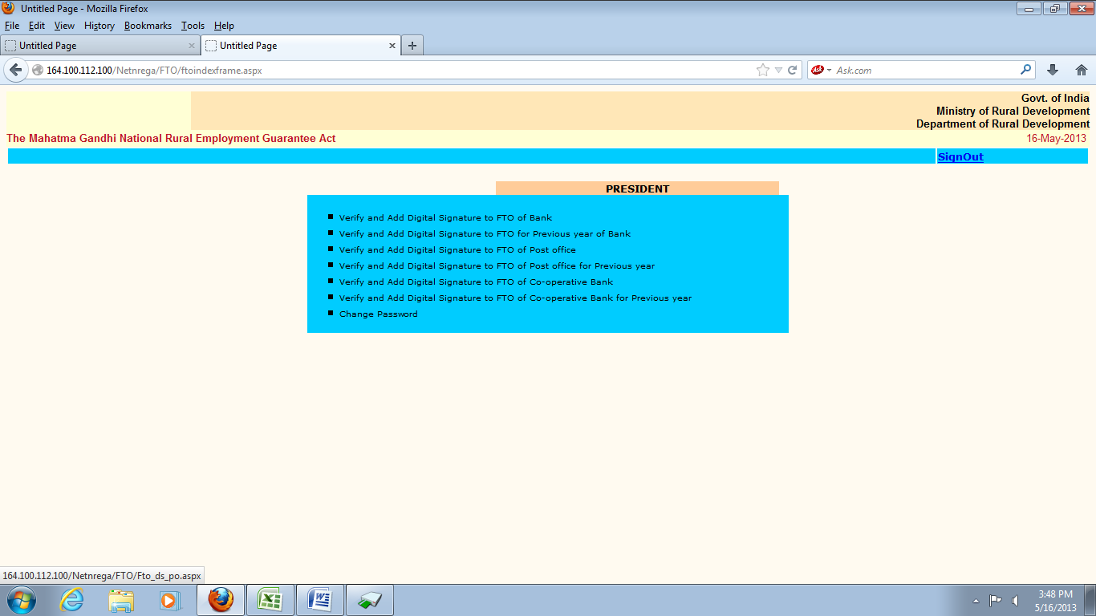

Slide 74
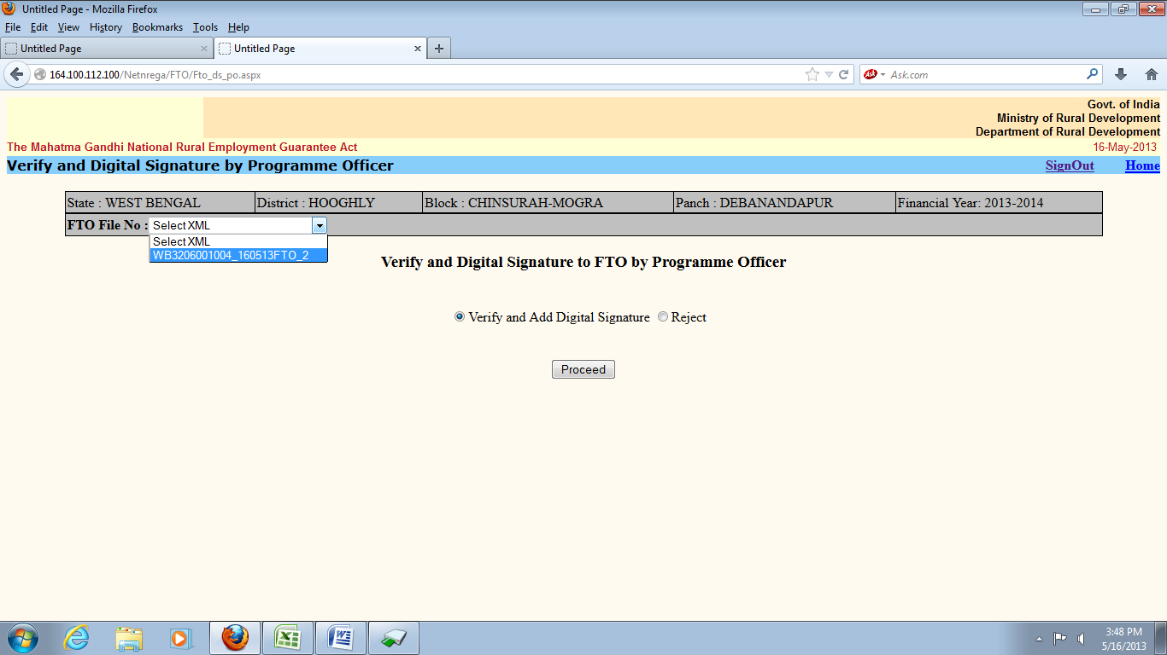

Slide 75
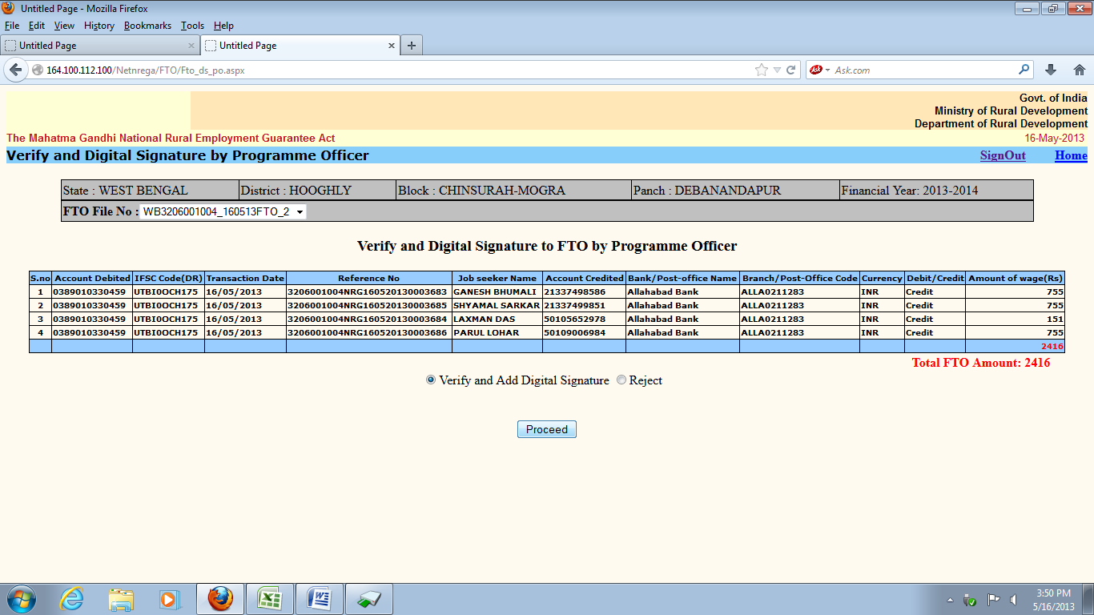

Slide 76


Slide 77


Slide 78
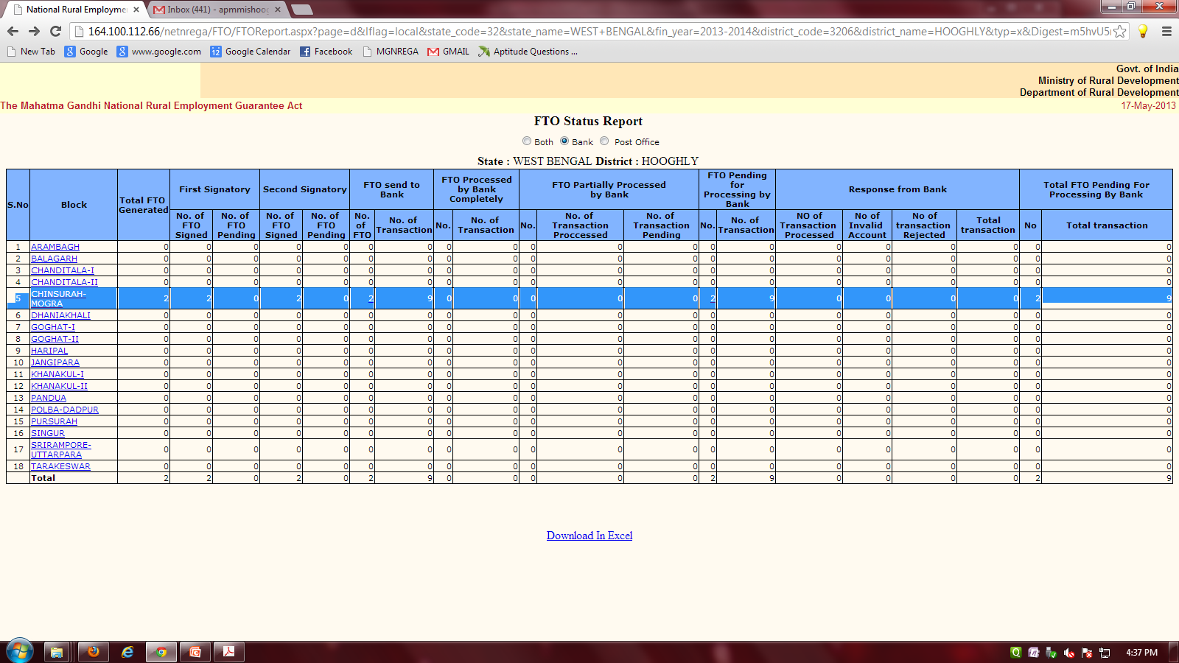

Slide 79


Slide 80


Slide 81


Slide 82
Processing at bank
The Bank has Provided IP address of one machine to NREGAsoft and only that machine of the bank can access the FTOs in their specified folder.
Bank will take these FTOs and Convert them to their CBS format.
All transaction Where the debtor and creditor bank is same will be get processed through internal CBS system
All transaction Where the debtor and creditor bank are different will be transacted through NEFT .
Bank Will Send the Response(fate) of Each transaction within 24 hours back to NREGAsoft.
Stanadard XML format is used to share information between NREGA soft and bank.

Slide 83
Thank you

